Slide 1
telePresence Tracking Project Results
Psychological Processing of Media Spring 2012
1

Slide 2
Frequency of presence experiences
Date | # of People with No Presence Experiences | # of People with Presence Experiences
4/11 | 7 | 11
4/13 | 10 | 8 (7)
4/14 | 7 | 11 (10)
4/15 | 8 | 9 (8)
4/16 | 8 | 6
TOTAL | 40 | 42
Only three people reported having had more than 1 presence experience
(1 person on 4/13, 1 person on 4/14, and 1 person on 4/15).
Just over half of the time, people reported having at least one presence experience.
During any given day, approximately an equal amount of people reported having
a presence experience and not having a presence experience.
2

Slide 3
Media technologies involved
Book | 1
Computer | 12
Film | 2
Radio | 5
Telephone - Cell | 6
Telephone - Land Line | 1
Television | 11
Video Games (Console) | 6
Other | 3
Telephone - Cell/Video Game | 1
Computer/Television | 1
Computer/laptop and television were the most represented media. Also a significant number of videogames, cellphones, and radio.
The least represented media were film, tablet PC, telephone-landline, book, and a mannequin.
7 of the 12 computer presence experiences occurred in situations where the person was using it for audiovisual purposes (i.e. for viewing, not for interactivity).
3

Slide 4
Elements of media experiences involved
Simultaneous experience of media elements
Media elements involved
Text | 8
Still Images | 3
Moving Images | 27
Sound | 34
Touch | 1
Smell | 1
Interactivity | 10
Other | 3
Text | 5
Still Images | 1
Moving Images | 3
Sound | 8
Touch | 0
Smell | 0
Interactivity | 3
Other | 2
Text, Touch, Interactivity | 1
Moving Images, Sound, Interactivity | 6
Moving Images, Sound | 15
Sound, Smell | 1
Text, Moving Images, Sound | 1
Text, Still Images, Moving Images, Sound | 1
Still Images, Moving Images, Sound | 1
Sound, Skype | 1
4

Slide 5
Elements of media experiences involved
The two elements of media experience that were involved most often were moving images and sound, followed by interactivity, then text and still images.
The elements of media experience least involved were touch and smell.
Common groupings of elements of media experiences were moving images and sound, followed by moving images, sound and interactivity.
Between two of the highest elements of media experiences involved (moving images and sound), sound was more often involved.
Engagement, social richness/presence and spatial presence occurred most often.
5

Slide 6
Media experience times
The most frequent times for presence experiences were between 4pm and midnight.
Presence tended to occur more frequently between the hours of 10pm and midnight. One explanation for this high number is that awareness to artificiality (i.e. mediation) decreases as fatigue increases, making presence easier to achieve.
Approximately 1 in 5 experiences lasted over 1 hour.
6

Slide 7
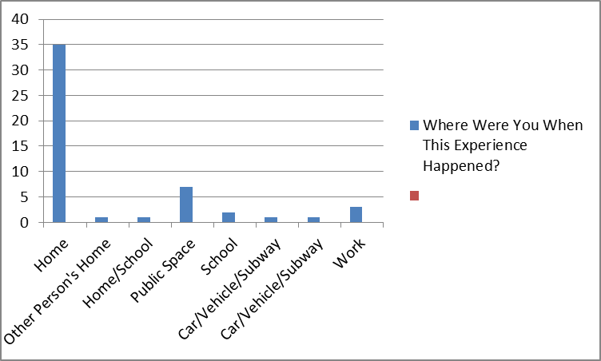
Participant location during experience
It may be that people experienced telepresence at “Home” more frequently than at any other location because it is easier to focus on and control the media experience with less distractions.
7

Slide 8
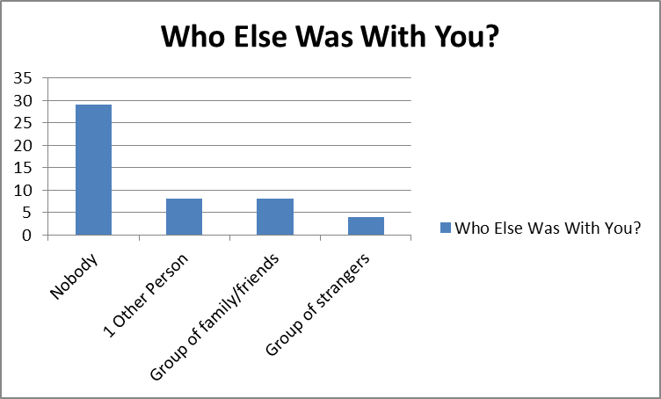
Participant accompaniment during experience
8

Slide 9
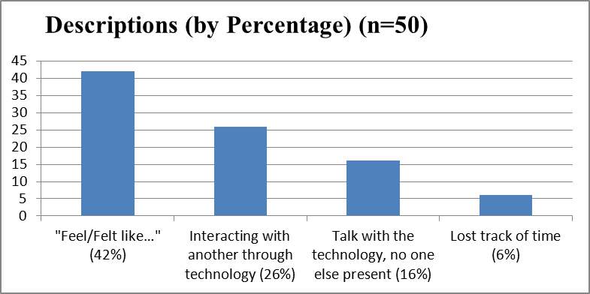
Description of presence experiences
Social interaction technology like Skype made interaction appear natural.
Participants often used the terms “feel” or “felt” in regards to their presence experiences.
Fictional work such as films or video games gave participants the experience of becoming the character.
9

Slide 10
What caused the experience to end
The most frequent cause for a telepresence experience being broken was the ending of said media as well as the medium itself being turned off.
Environmental factors that caused the experience to end included commercials, network lag, scene change, etc.
The majority of experiences ended unintentionally with unwanted breaks in presence.
10

Slide 11
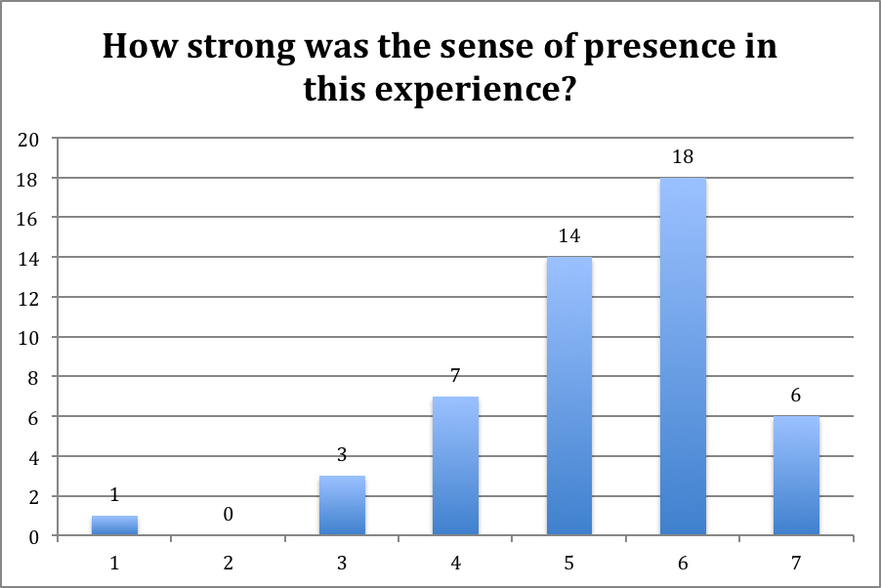
Intensity of presence experience
Majority of the experiences (38 of 49) were above the mid point of the scale (mean: 5.27).
Some people complained that the equipment (3-d glasses) detracted from the experience.
Some respondents recorded that the presence experience triggered past memories.
11

Slide 12
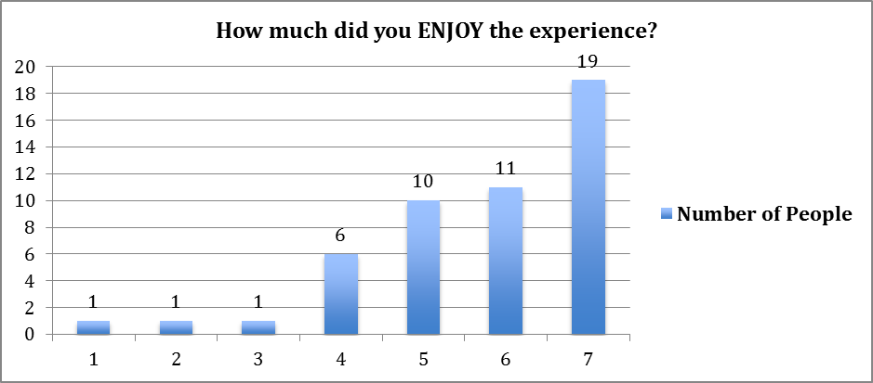
Level of enjoyment
62% of participants indicated that they enjoyed the presence experience.
19 of 30 participants indicated that they were alone when experiencing high levels of presence.
12

Slide 13
How much did it seem as if the objects and people you saw/heard had come to the place you were?
Participants experienced going to the place/towards the mediated content more than the feeling of objects and people coming to the place they were.
13

Slide 14
How much did it seem as if you could reach out and touch the objects or people you saw/heard?
Poor internet connection/lag decreased the presence sensation and increased the realization of physical boundaries.
Participants expressed having an emotional connection, but the lack of physicality was evident.
14

Slide 15
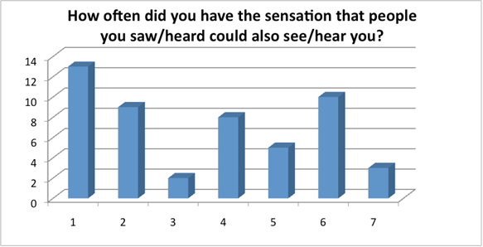
Sensation that people could see/hear you
Mean: 3.5
Median: 4
On being startled by a mannequin: “thought it [a mannequin] was a real person” (rated “5”)
Watching a recording of a live music performance on a large HDTV with surround: “more like a voyeur or separate participant, attending the concert” (rated “1”)
15

Slide 16
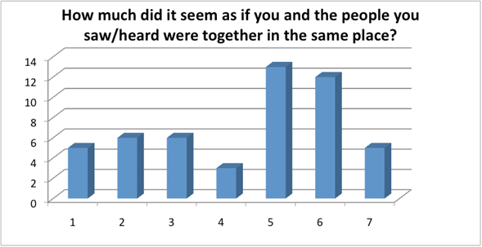
Sensation you were with mediated people
Mean: 4.38
Median: 5
16

Slide 17
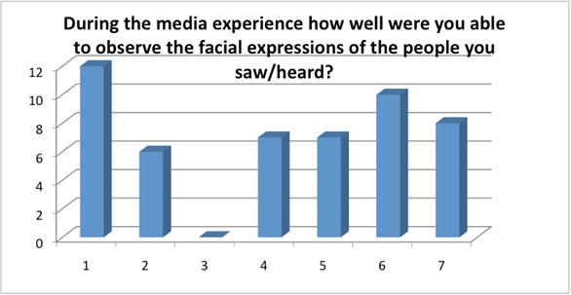
Ability to observe facial expressions
Mean: 4.06
Median: 4.5
Watching a movie: “I sat really close to my laptop” (rated “7”)
Reading a book: “Text doesn’t have facial... so..” (rated “1”)
On being startled by a mannequin: “that contributed to the experience because the mannequin's face was partially covered with dark glasses” (rated “2”)
17

Slide 18
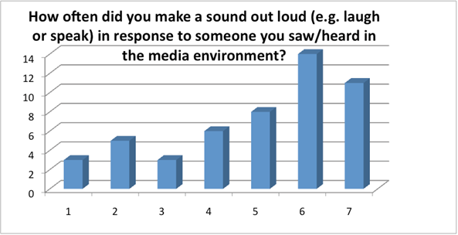
Vocal reaction during presence
Mean: 4.94; median: 5.5
Sport events, music, exciting television programming and video games prompted participants to respond out loud.
18

Slide 19
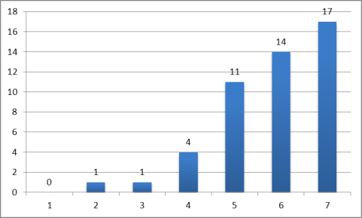
Extent of mental immersion
Most experiences of presence involved high levels of mental immersion.
19

Slide 20
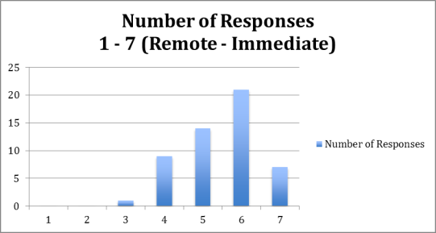
Social richness of experience
A majority of respondents experienced presence with moderate to high immediacy.
The most immediate experiences took place in the home without others.
20

Slide 21
Social realism
“The way in which the events I saw/heard occurred is a lot like the way
they occur in the real world.”
21

Slide 22
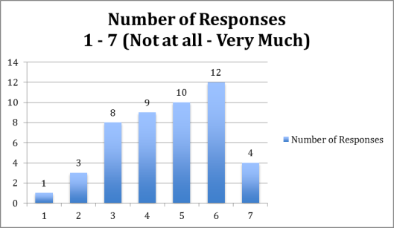
Social realism
How much did the things and people in the environment you saw/heard seem like they would if you had experienced them directly?
Mean: 4.6
Median: 4
22

Slide 23
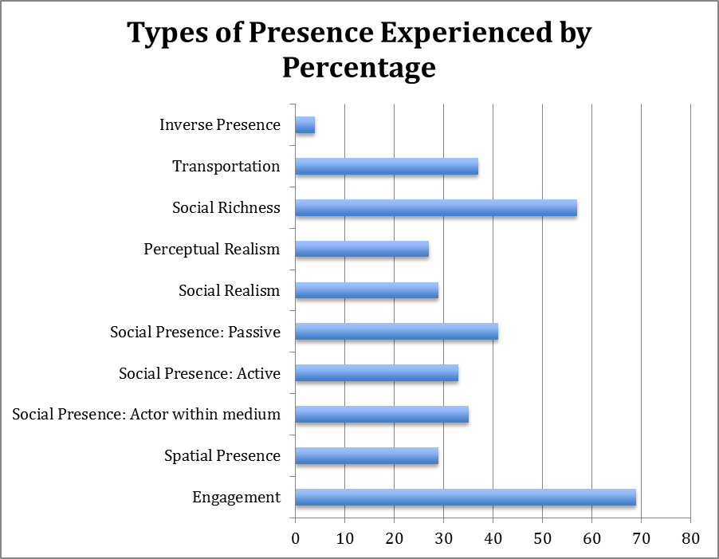
Types of presence experienced
55% of everyone who experienced social passive presence also experienced social active presence.
Mediated environments with visuals (such as computers, television, videogames, etc.) were more likely to evoke spatial presence.
59% of everyone who experienced social presence: actor within medium also experienced social active presence. This is likely because by definition actor within medium includes parasocial interaction.
23

Slide 24
Conclusions
First of its kind study has shown presence experiences by real people in natural “real life” settings can be ‘tracked’ and analyzed.
The participants reported having 0-2 presence experiences per day, with one a day most common.
Majority of experiences were at home; alone; late in the day; involved sound, moving pictures and the combination, and TV and computer especially for passive viewing; lasted under an hour; were strong and enjoyable; often prompted vocal reactions; and involved engagement, social richness and social presence.
Future use of our technique could use a ‘training video’ and a broader spectrum of participants over a longer period of time.
As technologies advance and our lives change, this technique has potential to demonstrate the evolution of the prevalence and types of presence experiences in coming years.
24

Slide 25
Congratulations to us
We did a great job!
25

