Slide 1
Presence and Food
Psychological Processing of Media MSP 4446
Spring 2018

Slide 2
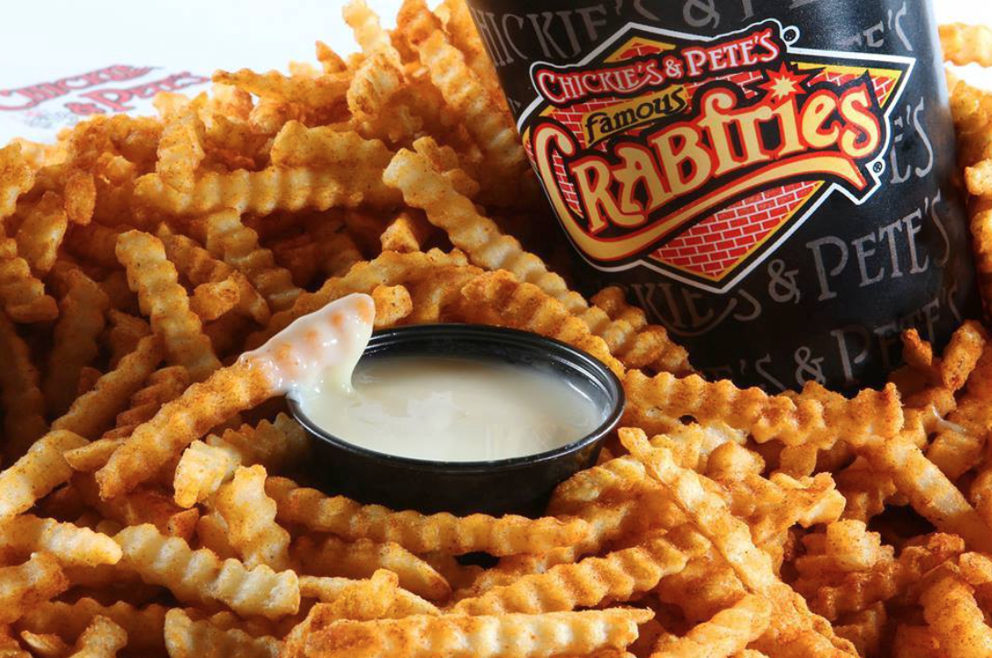
Picture 1

Slide 3
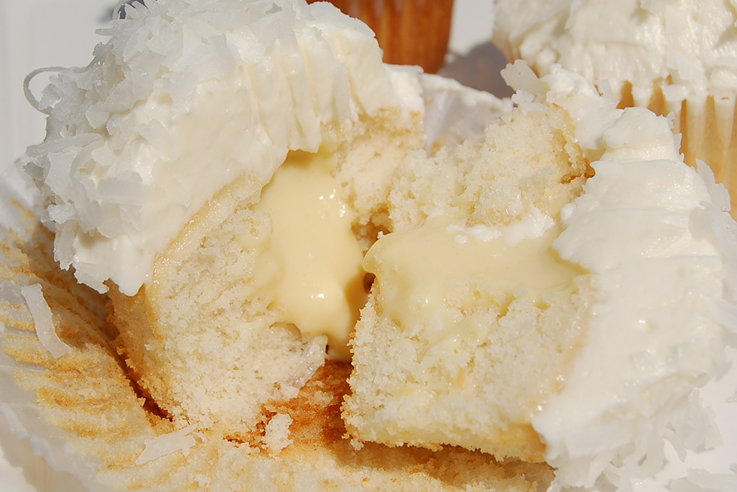
Picture 2

Slide 4
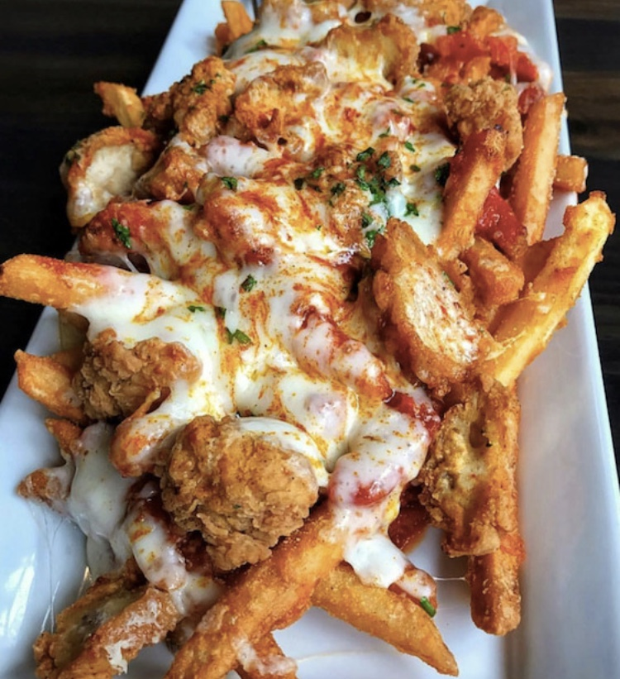
Picture 3

Slide 5
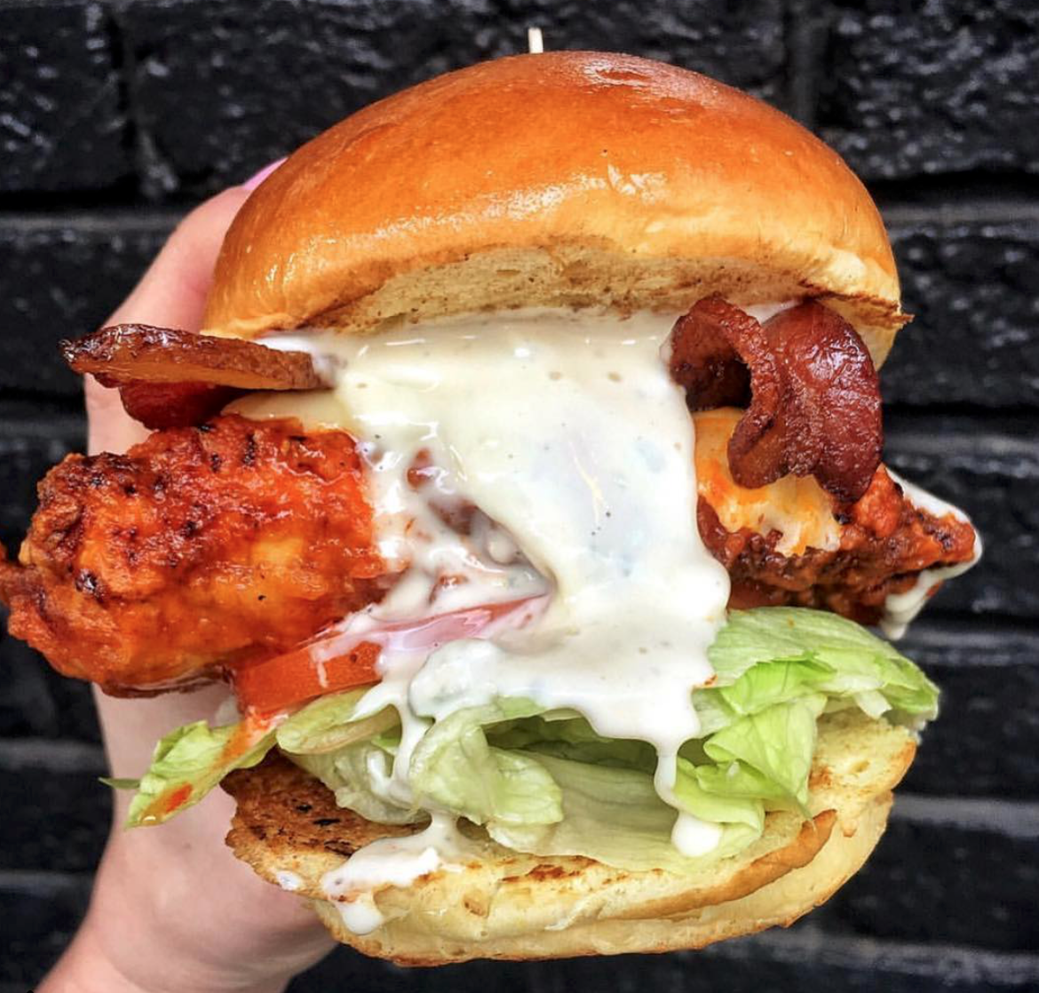
Picture 4

