Slide 1


An Introduction to (Tele)Presence
Matthew Lombard, PhD
Temple University
International Society for Presence Research

Slide 2
Overview
Defining (tele)presence
Types of presence
Creating presence
Why it matters
Discussion

Slide 3
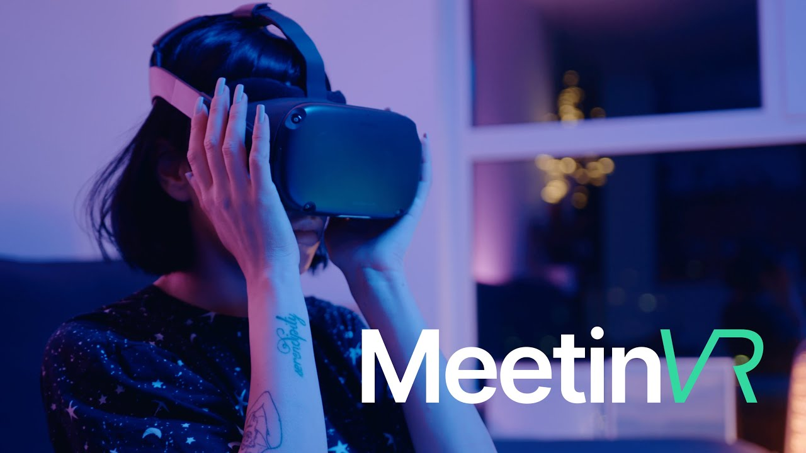
An example…
https://www.youtube.com/watch?v=dRp5VbWCQ3A

Slide 4
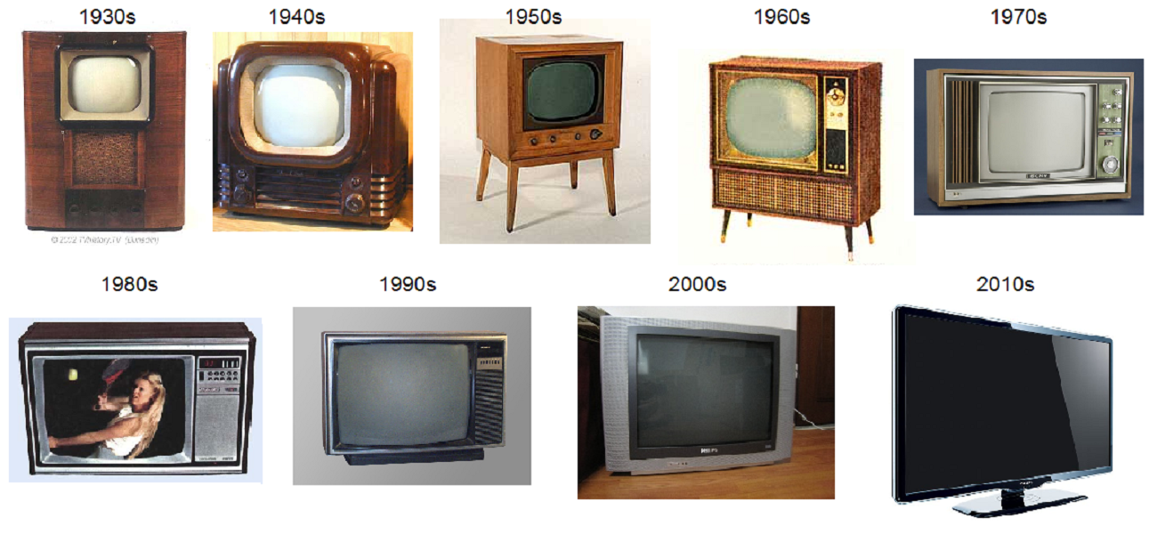
How media tech evolves

Slide 5
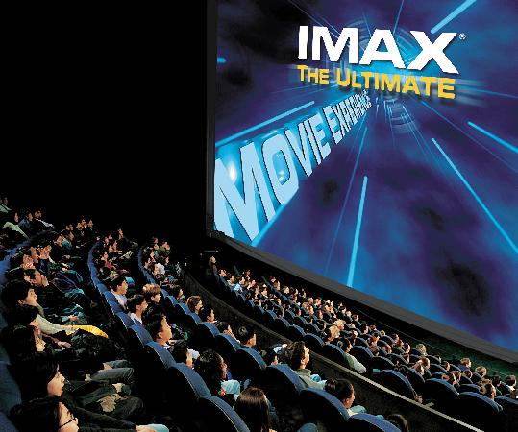
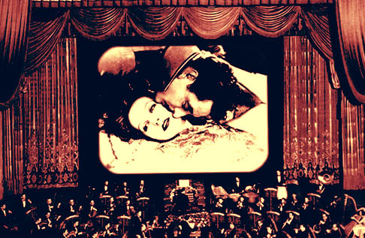
How media tech evolves

Slide 6
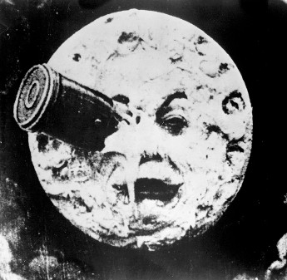
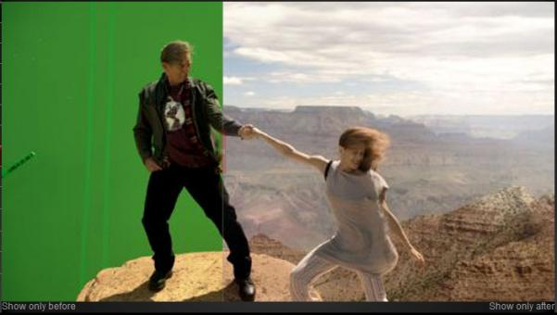
How media tech evolves

Slide 7
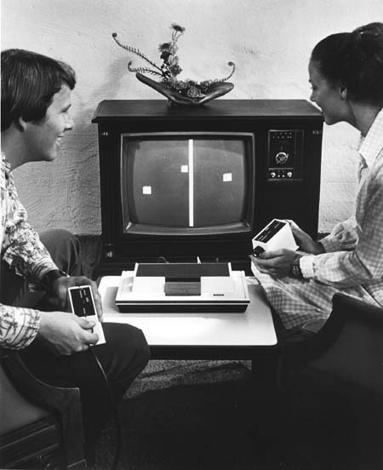
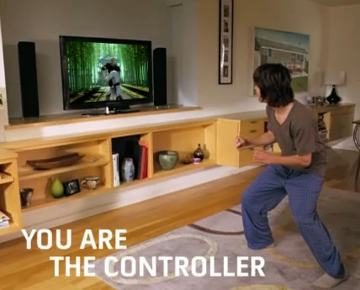
How media tech evolves

Slide 8
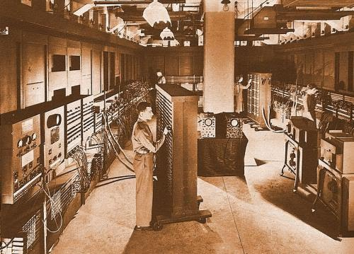
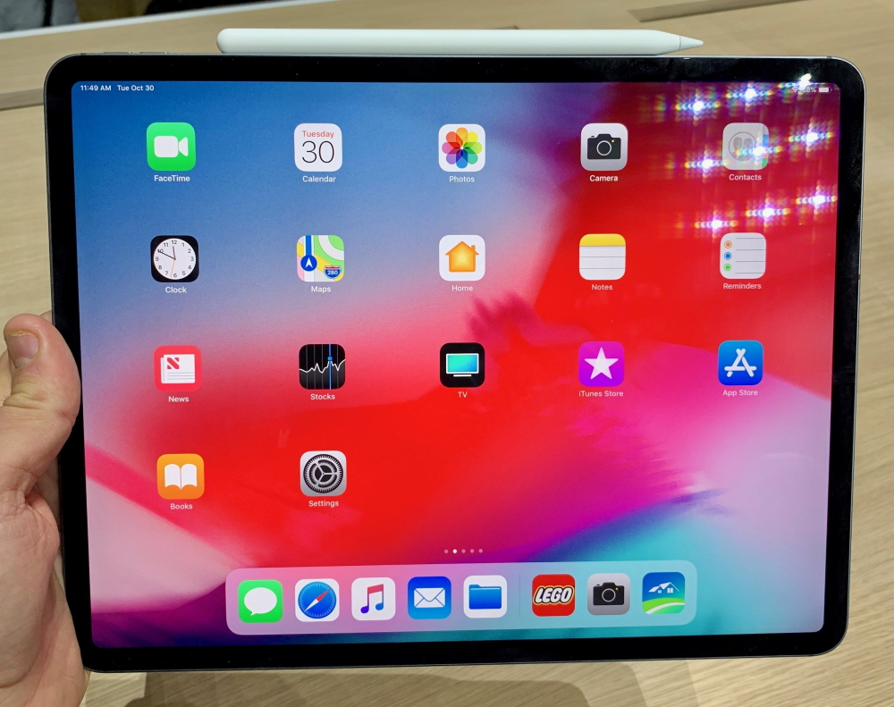
How media tech evolves

Slide 9
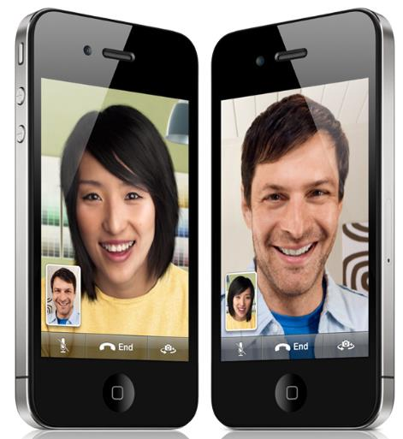
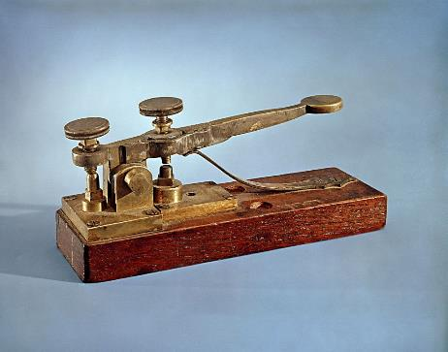
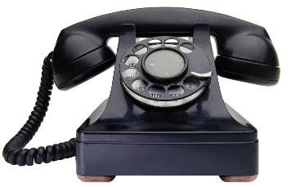
How media tech evolves

Slide 10
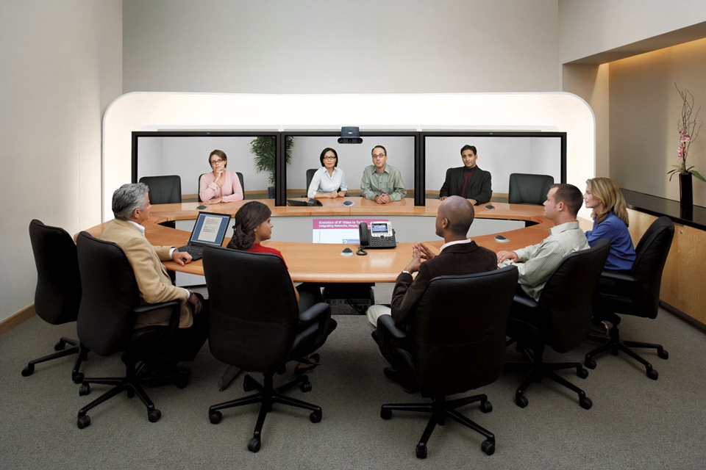
How media tech evolves

Slide 11
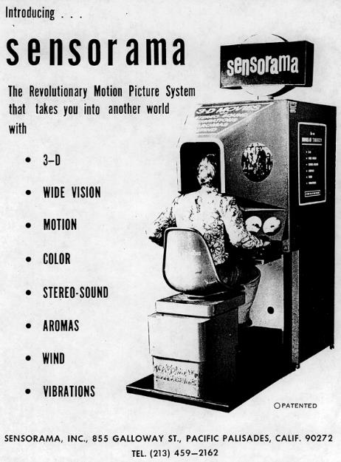
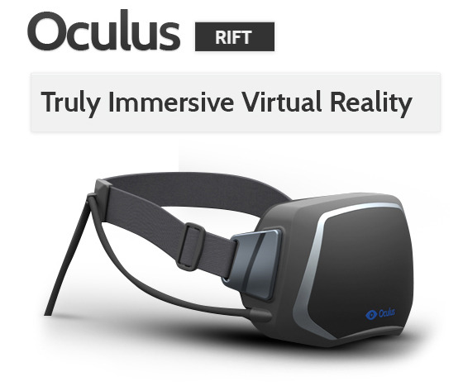
How media tech evolves

Slide 12
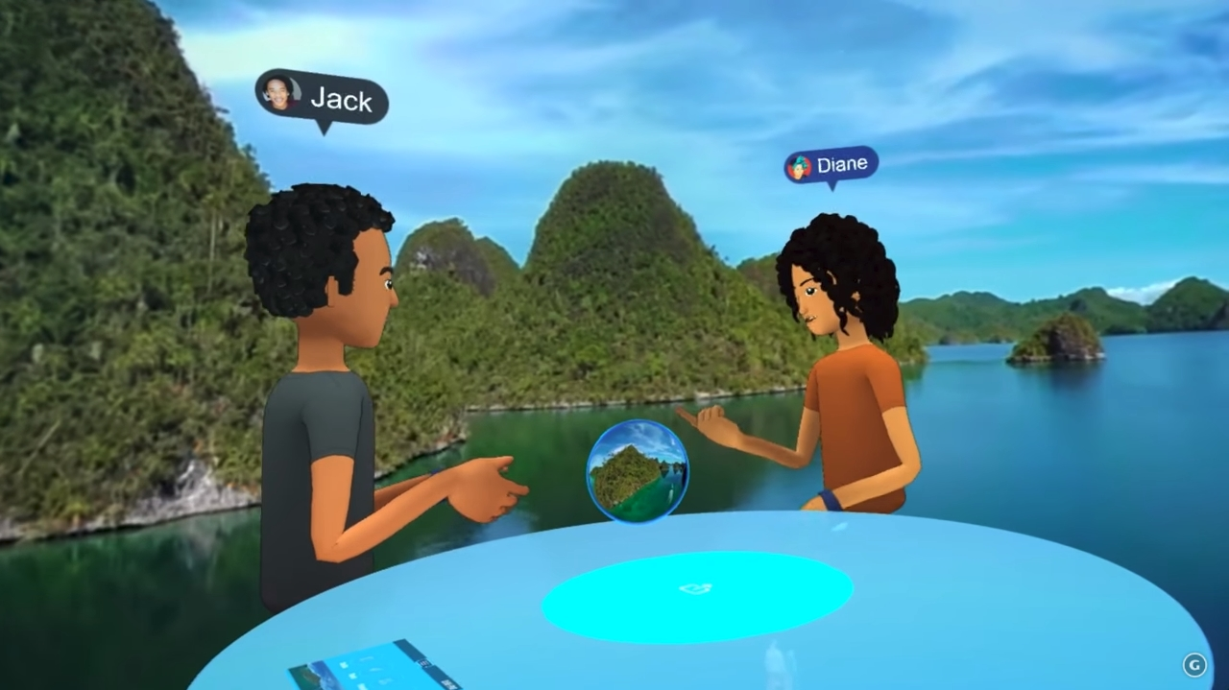
How media tech evolves
https://www.youtube.com/watch?v=PVf3m7e7OKU

Slide 13
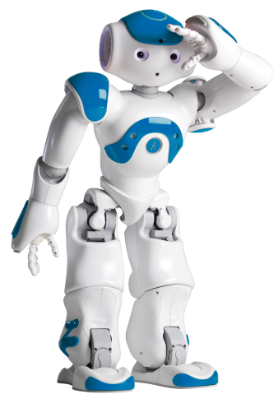
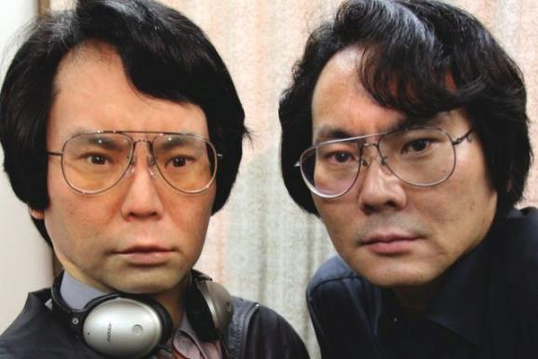
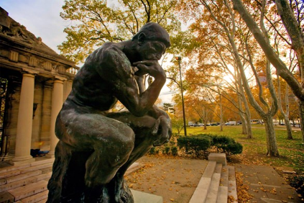
How media tech evolves

Slide 14
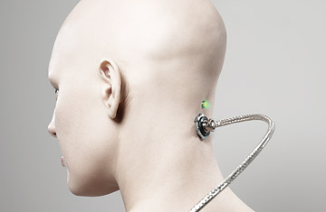
How media tech evolves

Slide 15
How media tech evolves
Using technology is becoming more
natural
intuitive
comfortable
easy
simple
automatic
‘real’
because it seems less like technology

Slide 16
Defining (tele)presence
A psychological state or subjective perception in which even though part or all of an individual's current experience is generated by and/or filtered through human-made technology, part or all of the individual's perception fails to accurately acknowledge the role of the technology in the experience.
[ISPR 2000]

Slide 17
Defining (tele)presence
“... When telepresence happens, the user feels present in or connected to the people or things in the media experience. We still know we're using a technology, but at some level we ignore the technology and just perceive the people, things and events of the experience. For example, we get ‘lost’ in the world of a novel, TV show, movie, videogame or theme park ride; we're convinced by the realism of paintings or graphic designs; we treat our cars, computers or other machines as if they have personalities of their own, and we feel like we're ‘with’ a person we talk to on the phone or in a videoconference. These are just a few examples; telepresence can happen with many other media too. ...”

Slide 18
Defining (tele)presence
A “perceptual illusion of nonmediation”
Real-time during media use
Not a disorder or abnormal
Property of media user
Result of media form and content,
media user characteristics and
media context/environment
A fragile ‘spell’ easily broken

Slide 19
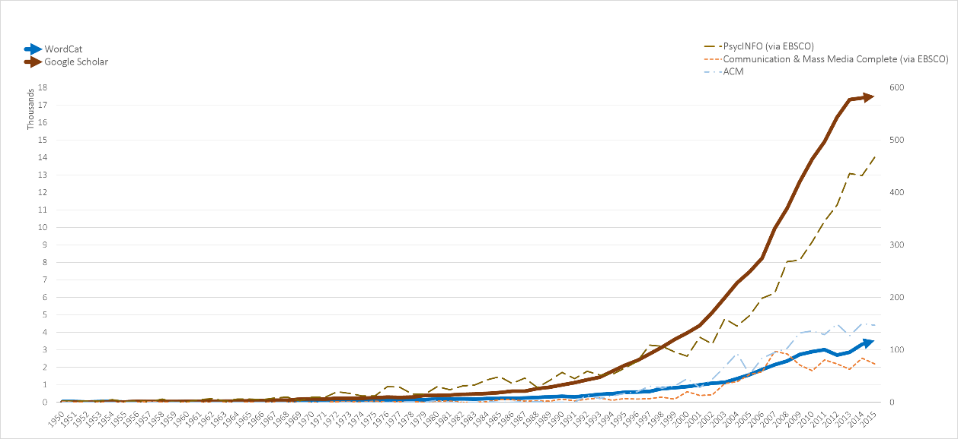
Presence research and theory
1990
2000
2010

Slide 20
Presence research and theory
An interdisciplinary area
Communication
Psychology
Computer Science
Philosophy
Medicine
Business
Education
Art
many others…

Slide 21
Overview
Defining (tele)presence
Types of presence
Creating presence
Why it matters
Discussion

Slide 22
Spatial presence
“I felt like I was in the SPACE OR ENVIRONMENT created by the technology”

Slide 23
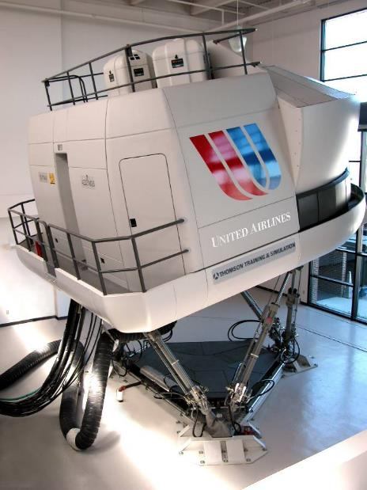
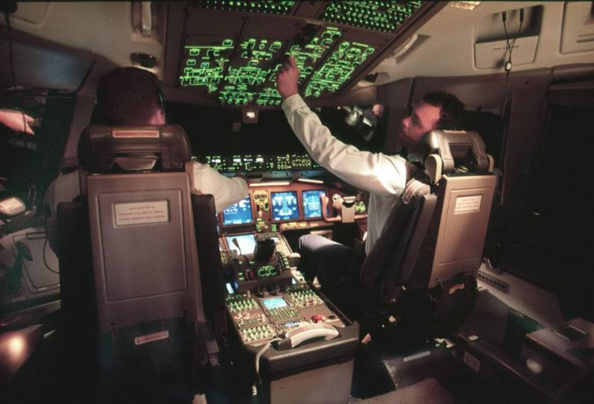

Slide 24
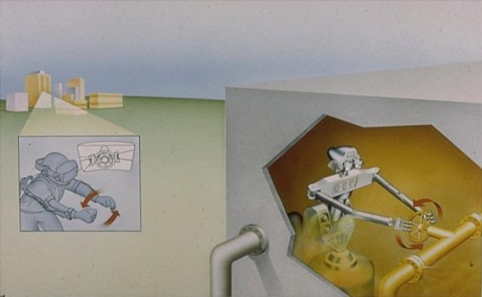
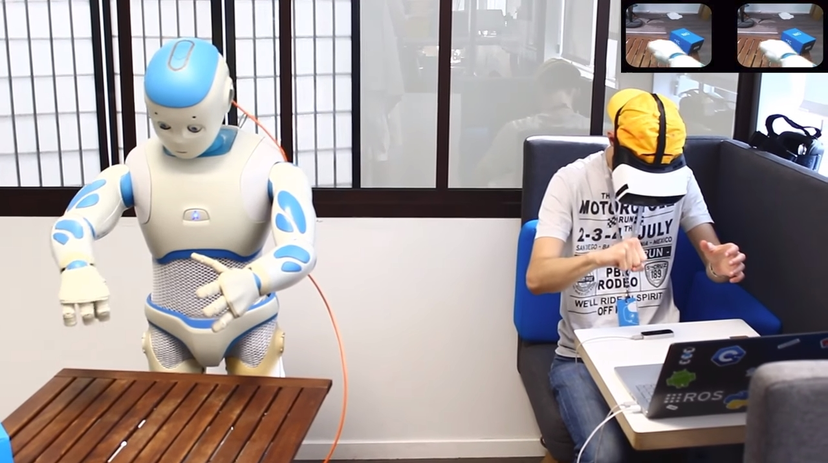
https://www.youtube.com/watch?v=CxmvPB3by1w

Slide 25



Slide 26
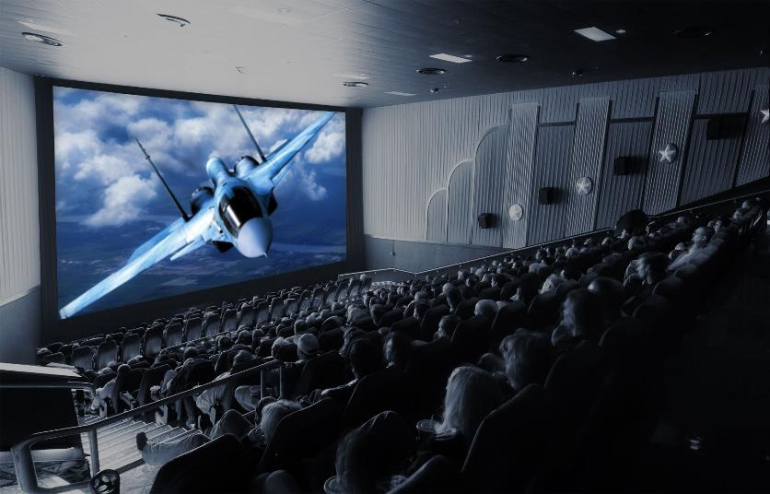
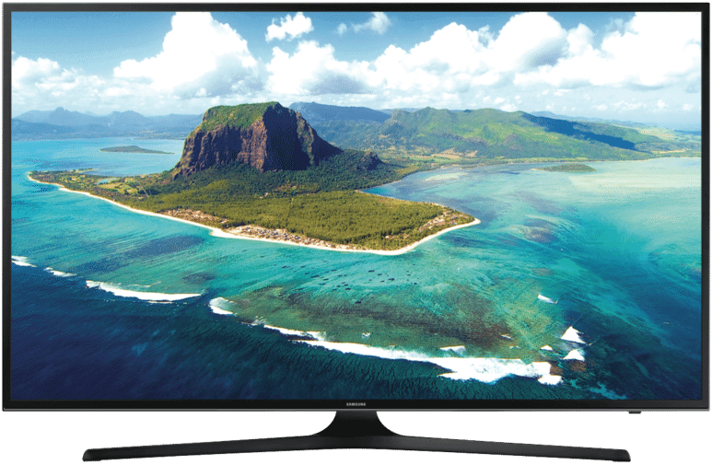

Slide 27
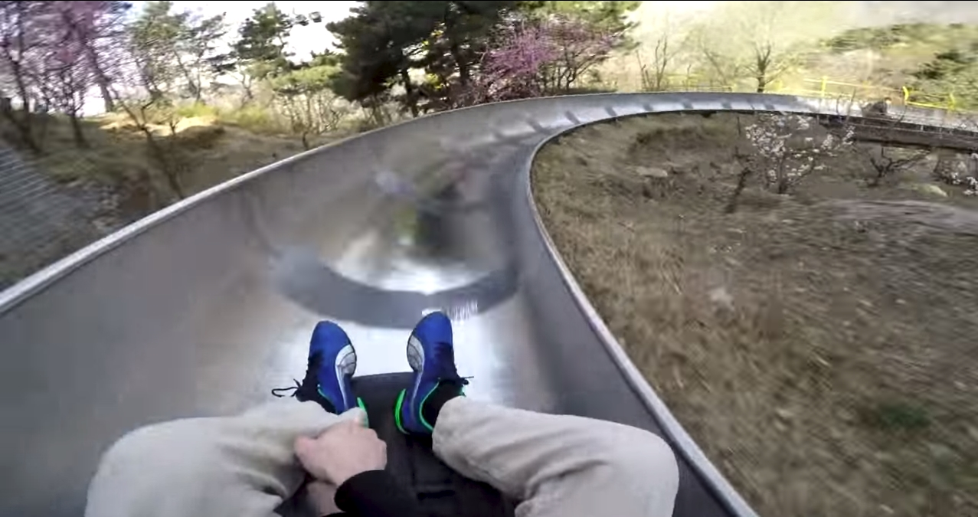
https://www.youtube.com/watch?v=ZJJU72CZiF8

Slide 28
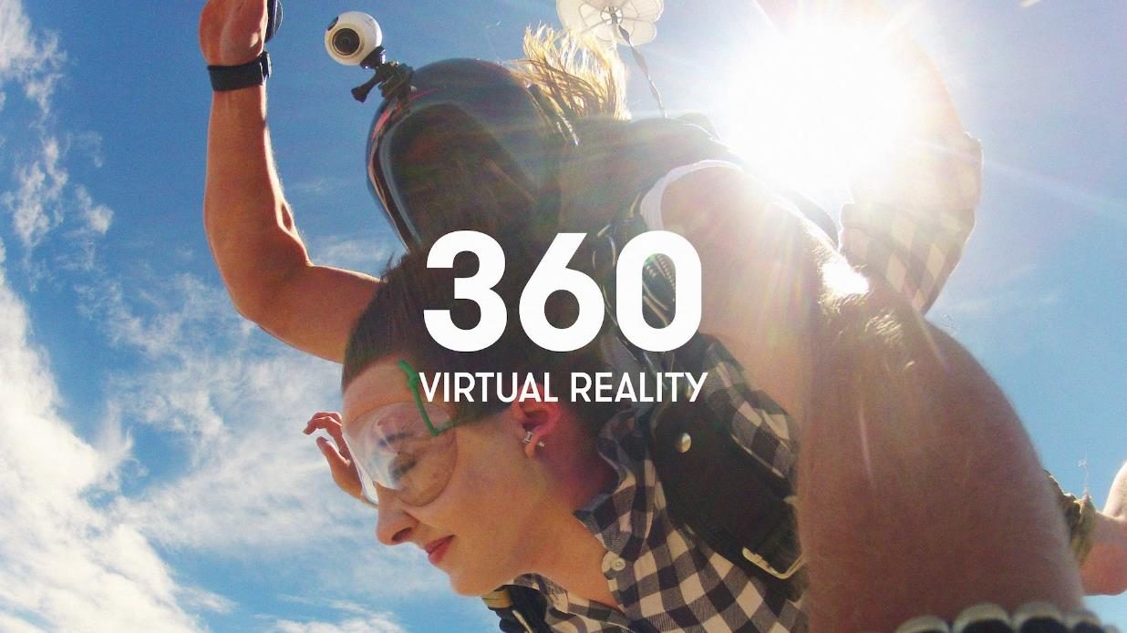

Slide 29
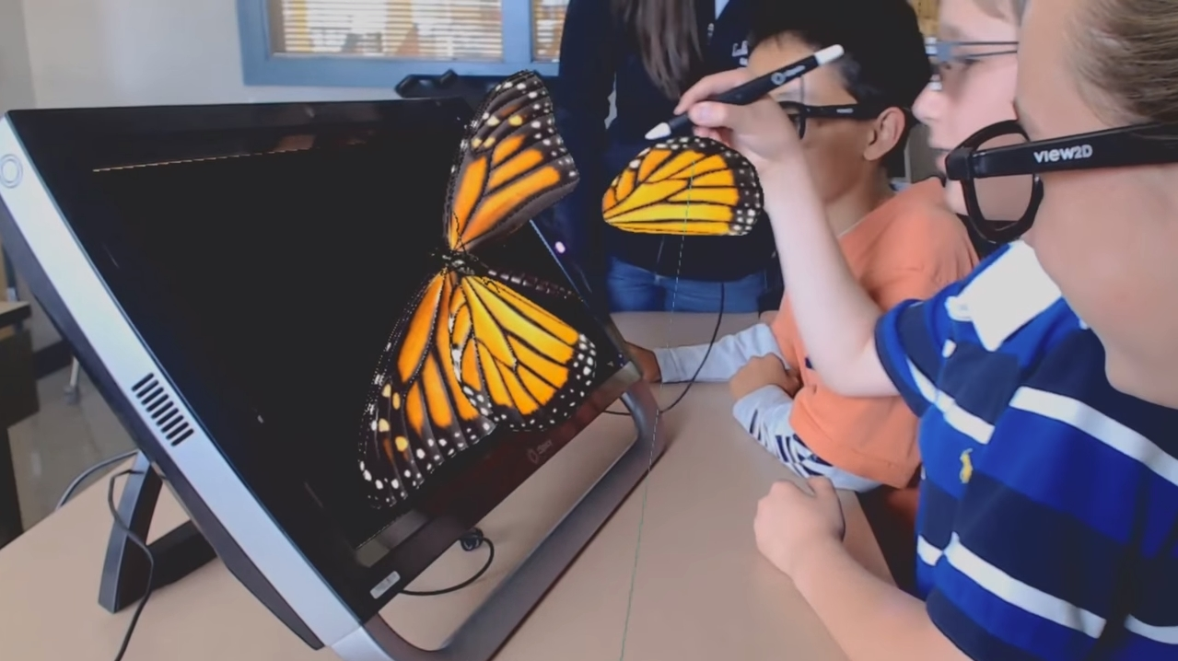
https://www.youtube.com/watch?v=hRmkkrafboo

Slide 30
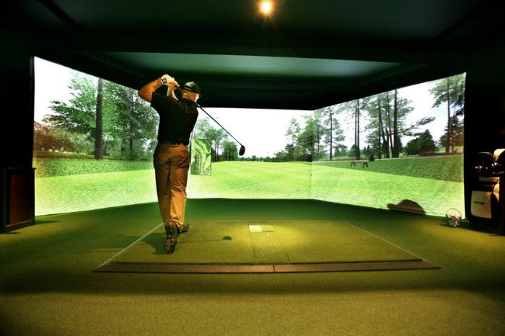
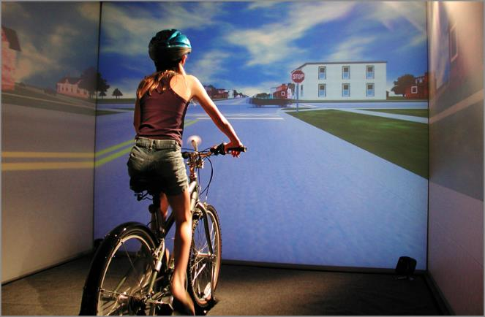

Slide 31
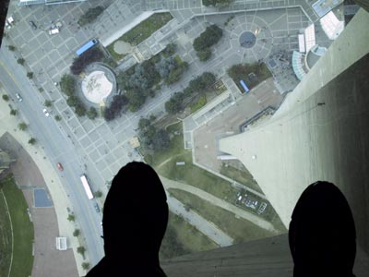
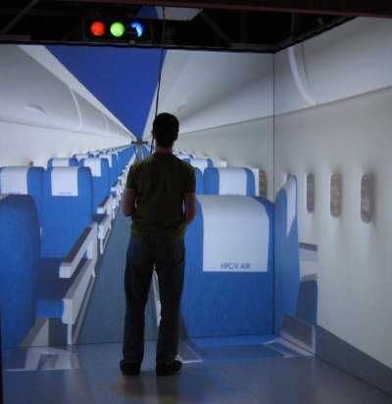

Slide 32
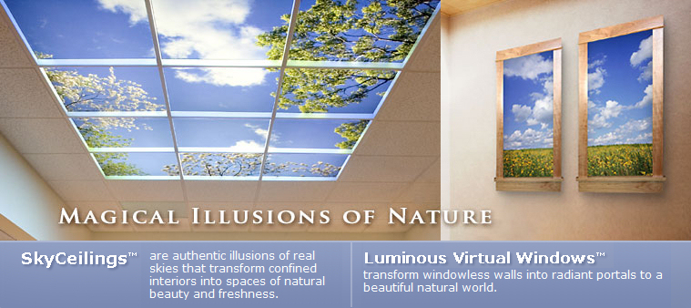

Slide 33
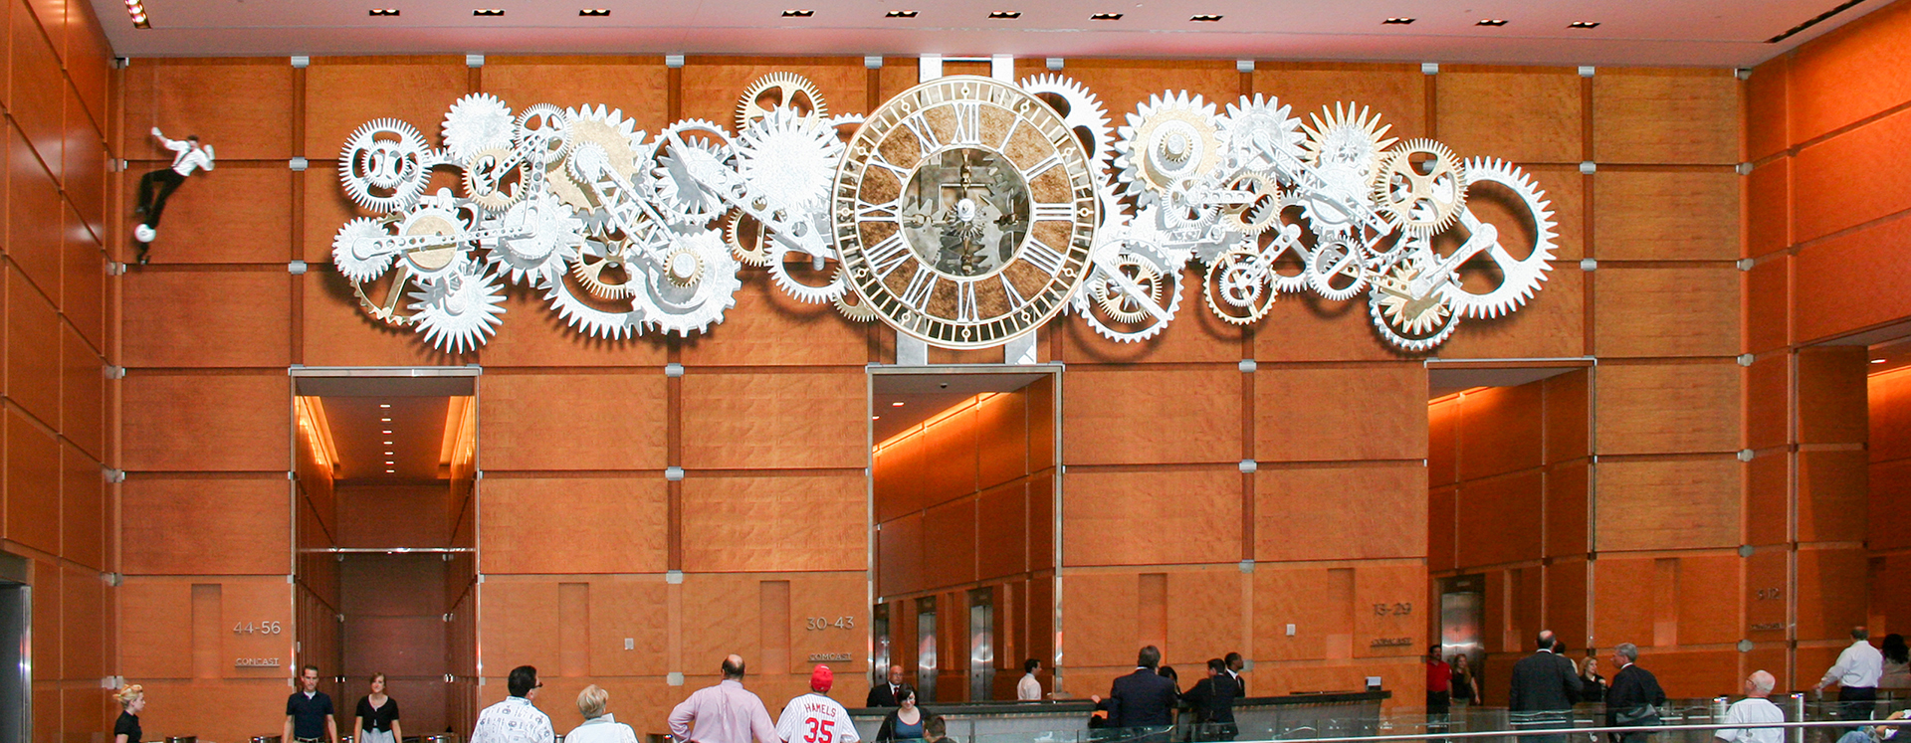
https://www.youtube.com/watch?v=WSRcDrCse7c

Slide 34
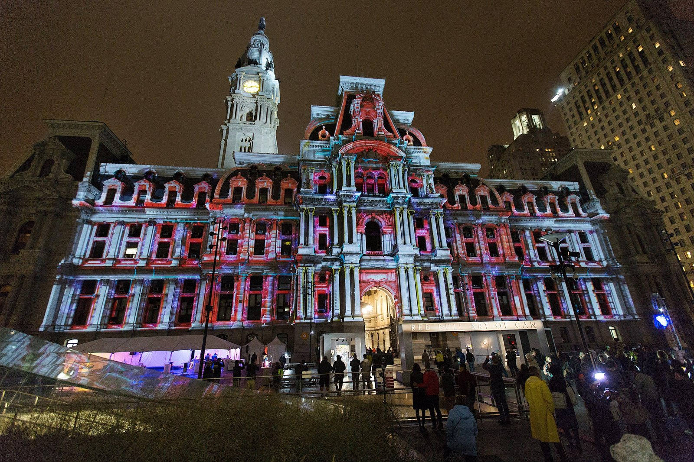
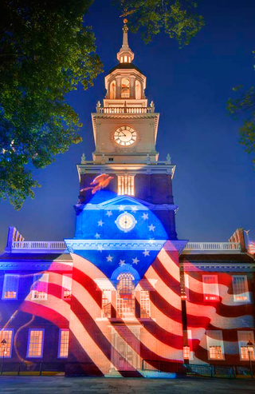

Slide 35
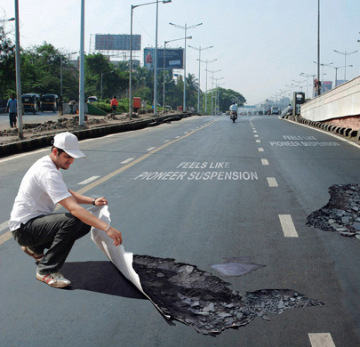
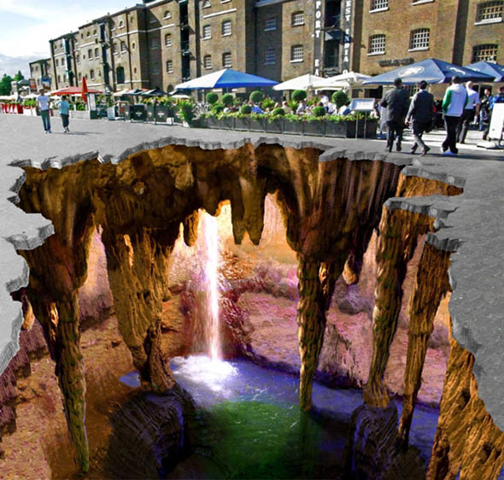
Advertising

Slide 36
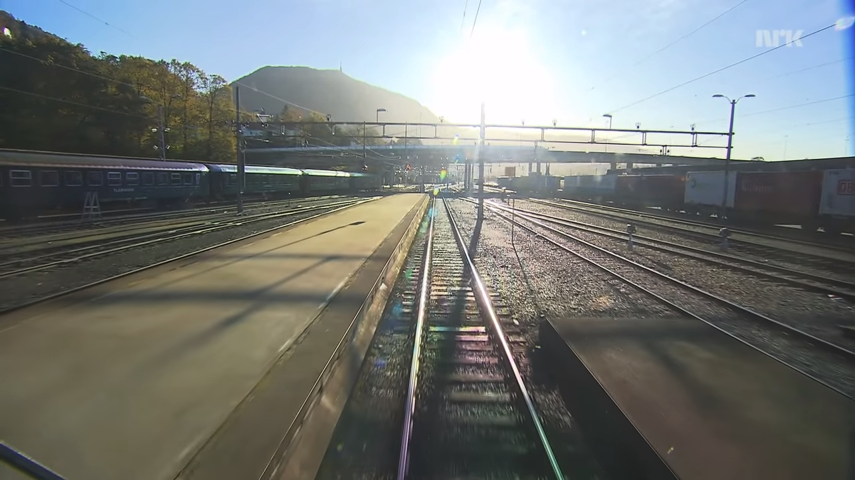
https://www.youtube.com/watch?v=xisVS_DKpJg (example)
https://www.youtube.com/watch?v=4Ibe17-JMCU (news story)

Slide 37
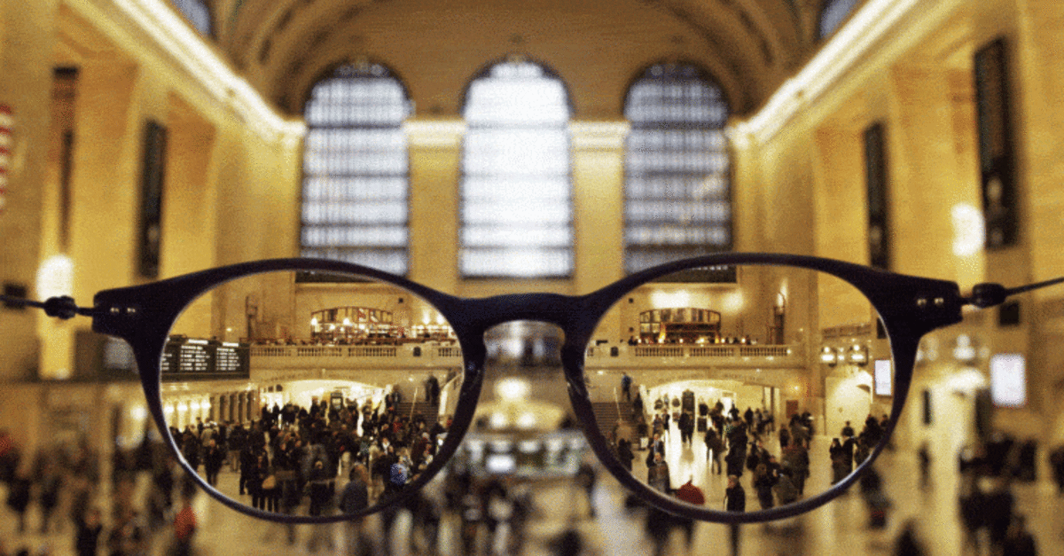

Slide 38
Social presence – 1 way
(actor within medium)
“Even though I COULDN'T INTERACT with them, I FELT I WAS ACTUALLY WITH THE PEOPLE or characters who were available via the technology”

Slide 39
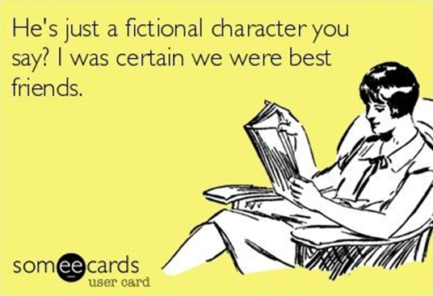
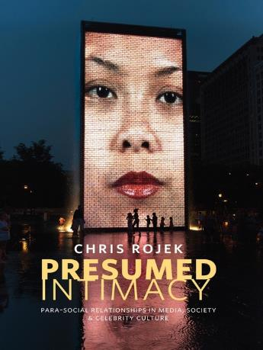

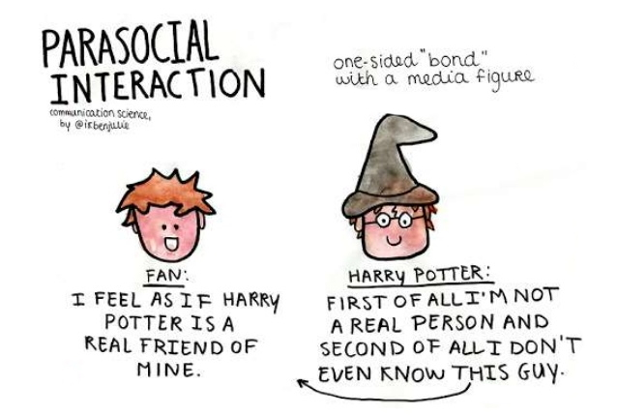
Lonesome Gal - Info: https://info.umkc.edu/specialcollections/archives/854
Audio: https://www.youtube.com/watch?v=hs-Kr53pCAE

Slide 40
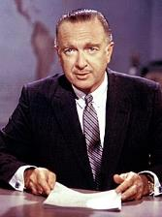
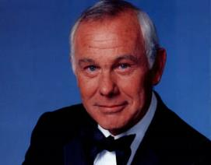
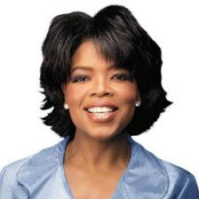
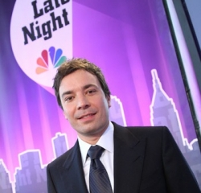








Slide 41
http://www.nickjr.com/blues-clues/

Slide 42


Slide 43

http://maartenbaas.com/real-time/schiphol-clock/

Slide 44
Social presence - 2 way
“I felt I was actually with the PEOPLE who were available via technology”

Slide 45


Slide 46



Slide 47


Slide 48


Virtual testimony

Slide 49


Slide 50



Slide 51



Slide 52




Slide 53




Slide 54

https://learningenglish.voanews.com/a/robot-goes-to-school/3830253.html (news story)

Slide 55

https://www.youtube.com/watch?v=Zmqva2rkVXA (ad)
https://www.youtube.com/watch?v=7ZFRC1ab-uk (vision)

Slide 56
Social presence - 2 way
“I felt I was actually with the PEOPLE who were available via technology”
with artificial actor

Slide 57


Customer service

Slide 58




Slide 59

Customer service
https://www.youtube.com/watch?v=D5VN56jQMWM

Slide 60
Medium as social actor (MASA) presence
“The technology itself SEEMED TO HAVE A PERSONALITY (including computers, phones, robots, mannequins, etc.)”

Slide 61



Slide 62




Slide 63



https://www.youtube.com/watch?v=5ifwGc-0mAY

Slide 64

https://www.youtube.com/watch?v=fSByydx1JdU

Slide 65



Slide 66



Slide 67

https://www.youtube.com/watch?v=cV_D2hC50Kk (at U.N.)
https://www.youtube.com/watch?v=W0_DPi0PmF0 (news story)

Slide 68



The case of clocks

Slide 69
The case of clocks
They have faces, hands, and bodies
They move – pendulums, cuckoo birds, eyes, gears, metal balls
They have “voices” – ticking, chiming, spring resets
Nearly infinite number of models; antiques are unique
They have lifespans, “illnesses” that require a “doctor”
They evoke emotional attachments
They are missed and recalled fondly

Slide 70


The case of clocks

Slide 71



The case of clocks

Slide 72




The case of clocks

Slide 73


The case of clocks

Slide 74



The wider view

Slide 75


The wider view

Slide 76







The wider view

Slide 77
Self-presence
“I felt connected to the AVATAR OR OTHER REPRESENTATION OF ME in the world created by the technology”

Slide 78

https://www.youtube.com/watch?&v=sv6T-tg6RL4
https://skarredghost.com/2020/08/11/daniel-beauchamp-quest-hands-ux/
https://uploadvr.com/new-quest-hand-tracking-demos/

Slide 79
Inverse presence
“Even though I WASN'T USING TECHNOLOGY, I FELT LIKE I WAS”

Slide 80



Slide 81
Multiple kinds of presence!

Slide 82



Slide 83
More types of presence
Lombard, M., & Jones, M. T. (2015). Defining presence. In Immersed in Media: Telepresence Theory, Measurement and Technology. London: Springer.

Slide 84
More examples
ISPR PRESENCE NEWS
International Society for Presence Research
http://ispr.info

Slide 85
Overview
Defining (tele)presence
Types of presence
Creating presence
Why it matters
Discussion

Slide 86
Creating presence
Research, theory and experience suggest steps to increase presence via FORM:
Make images (and field-of-view) big
Increase image and sound resolution/quality
Use subjective camera shots
Comfortable to high volume
Add stimulation of more senses (e.g., touch, smell)

Slide 87
Creating presence
Research, theory and experience suggest steps to increase presence via FORM:
Make experience interactive with natural interface, accurate tracking
Reduce lags
Make it seem live vs. recorded, constructed
Hide technology, remove glitches
Use gradual transitions pre/post experience

Slide 88
Creating presence
Research, theory and experience suggest steps to increase presence via CONTENT:
Make it plausible (socially realistic)
Make it personally relevant
Avoid media conventions (formula plot/dialogue, 555-, etc.)
Make task or activity moderately challenging

Slide 89
Creating presence
Research, theory and experience suggest steps to increase presence via CONTEXT:
Create/encourage relaxed and comfortable physical and social settings

Slide 90
Overview
Defining (tele)presence
Types of presence
Creating presence
Why it matters
Discussion

Slide 91
Why presence matters
Common – increasingly as media tech evolves
Central – applications across nearly all fields and endeavors, especially communication
$$$ – basis for diverse large, profitable markets
Effects – on individuals, couples, families, organizations, societies, nations
Ethics – raises big issues and challenges
Cool – just really interesting (!)

Slide 92



Why presence matters
https://www.youtube.com/watch?v=13cbF8s68cU (video)
http://bgr.com/2017/12/30/meet-the-ai-startup-that-wants-to-make-a-digital-copy-of-every-person-in-the-world/ (story)
THIS X DOES NOT EXIST: https://thisxdoesnotexist.com/

Slide 93


Why presence matters
A

Slide 94

Our presence projects
Presence and music (2006), with Jack Klotz
Presence and sexuality (2013), with Matthew Jones
Presence and death (2008), with Melissa Selverian
Presence and philosophy (2011), with Matthew Jones and Joan Jasak

Slide 95
Our presence
projects
Presence in popular culture (ongoing), with many people

Slide 96


Our presence projects

Slide 97
More information
Matthew Lombard
http://matthewlombard.com
lombard@temple.edu
International Society for Presence Research (ISPR)
http://ispr.info

Slide 98

More information
International Society for Presence Research (ISPR)
http://ispr.info

Slide 99
Overview
Defining (tele)presence
Types of presence
Creating presence
Why it matters
Discussion

