Slide 1
Presence and Food
Psychological Processing of Media MSP 4446/8446
Fall 2018

Slide 2
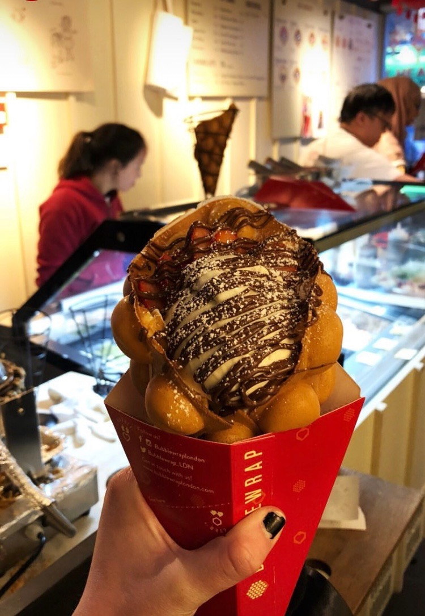
Picture 1

Slide 3
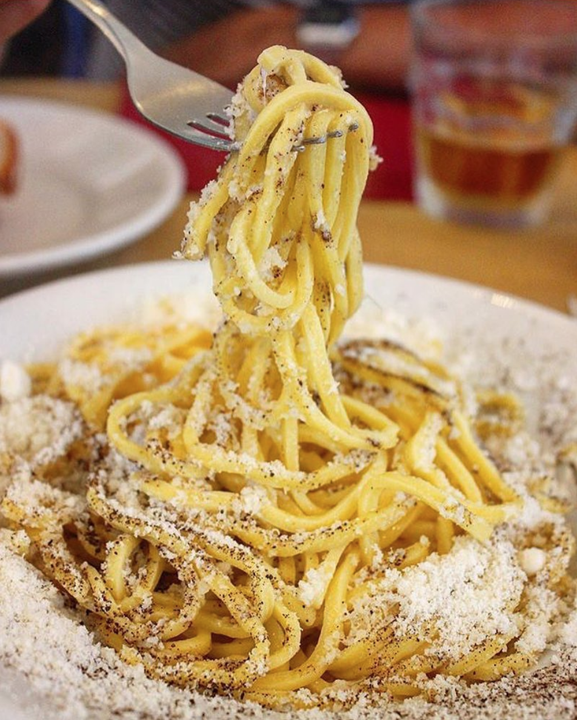
Picture 2

Slide 4
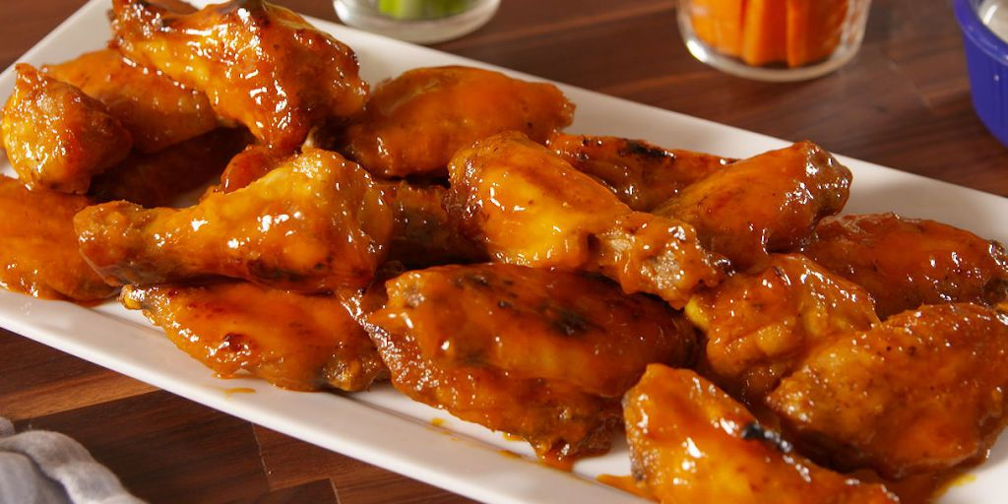
Picture 3

Slide 5
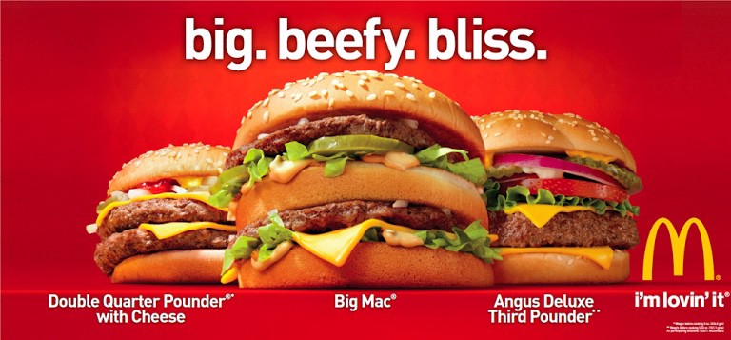
Picture 4

Slide 6
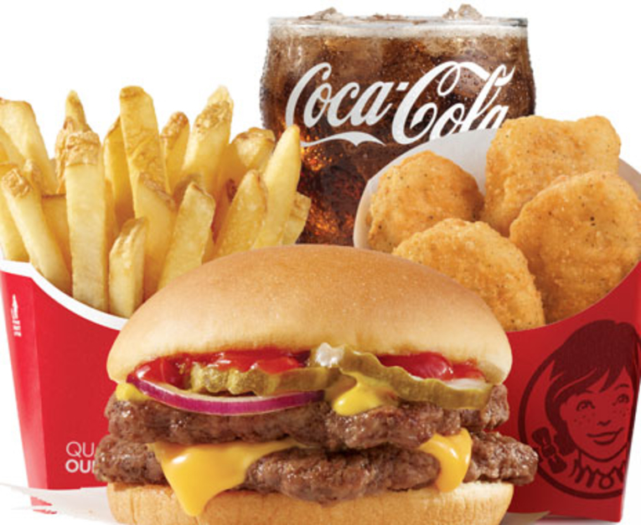
Picture 5

Slide 7
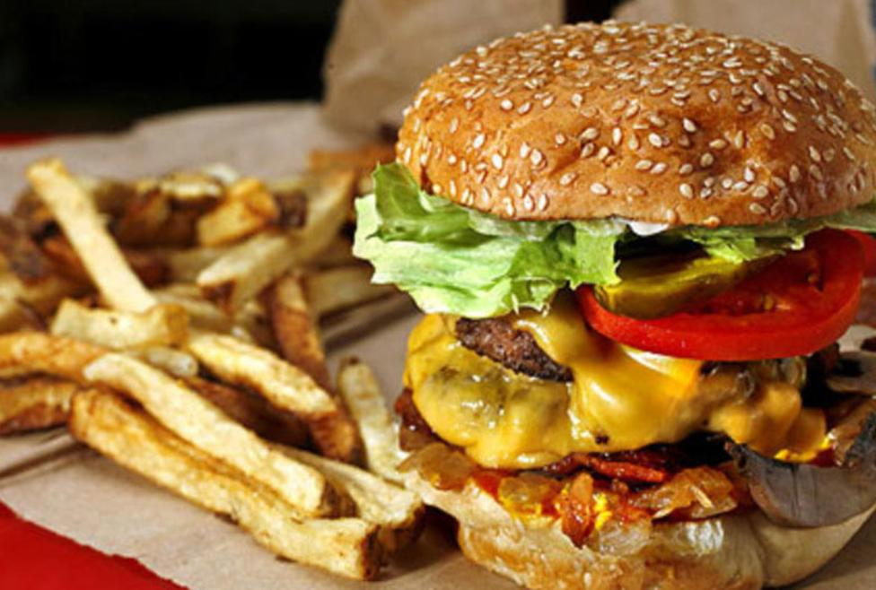
Picture 6

Slide 8
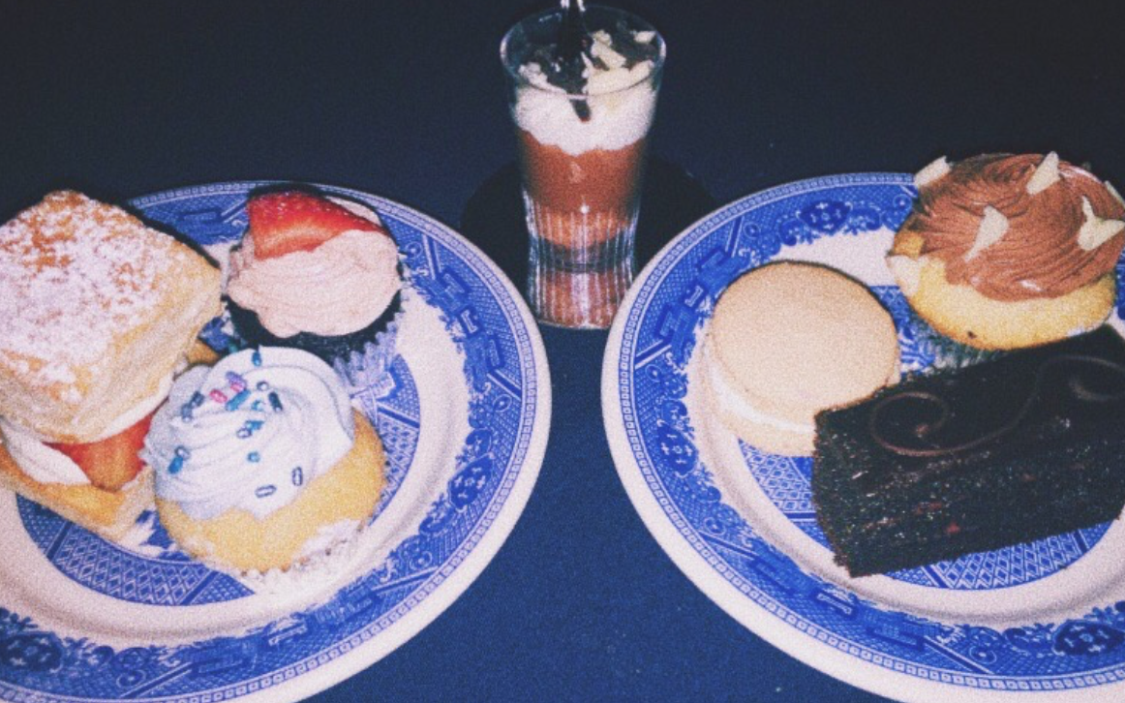
Picture 7

Slide 9
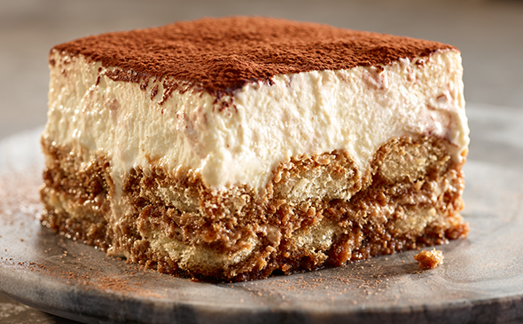
Picture 8

Slide 10
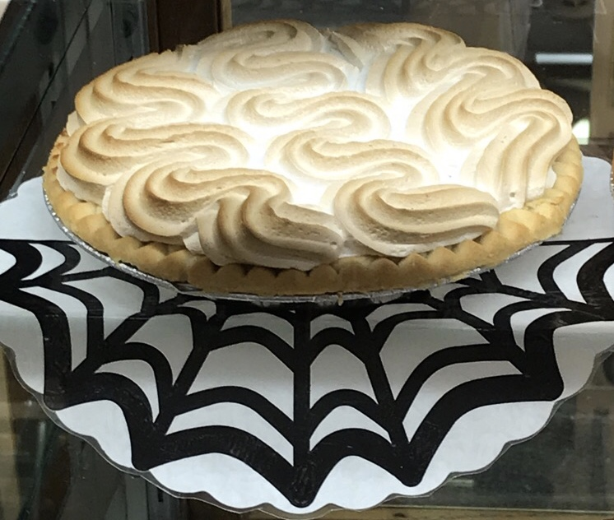
Picture 9

Slide 11
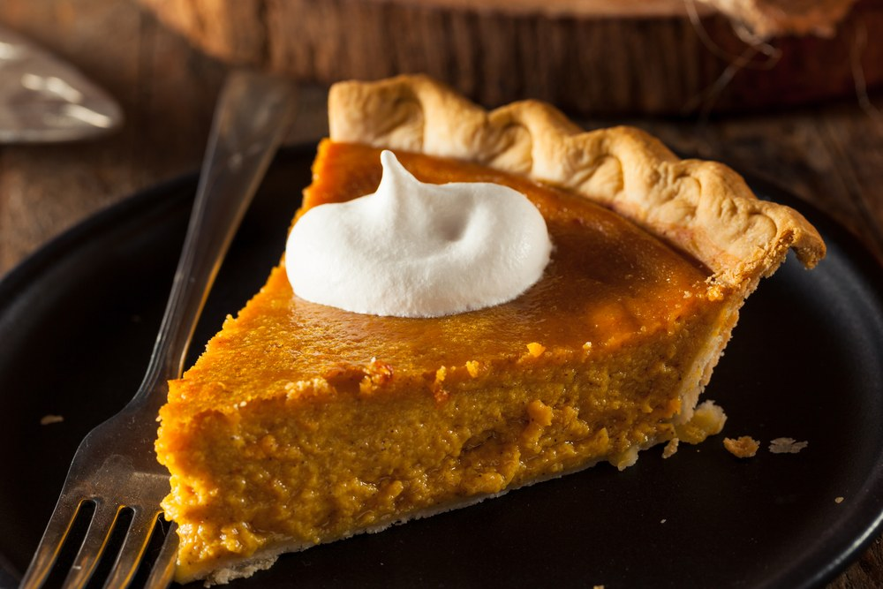
Picture 10

