Slide 1
PRESENCE + 360° VIDEO
Laura Zaylea, MFA
Matthew Lombard, Ph.D.
MSP 4741/8741/4446 Fall, 2018

Slide 2
Thursday, 9/6/18 - Today’s Agenda
Review: Types of Presence
Screening and Discussion: 360° Video
Assign groups + check out cameras!

Slide 3
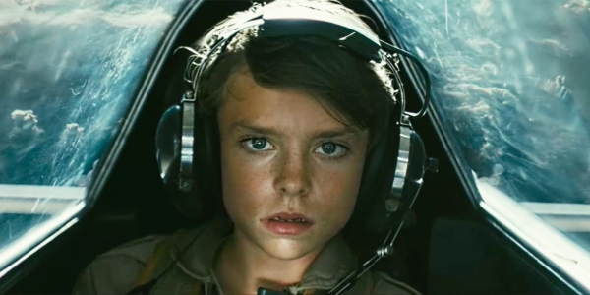
But first…
Ad on vimeo: https://vimeo.com/287395023
ISPR Article: https://ispr.info/2018/09/06/swedens-com-hem-ad-campaign-vividly-illustrates-presence-experiences/

Slide 4
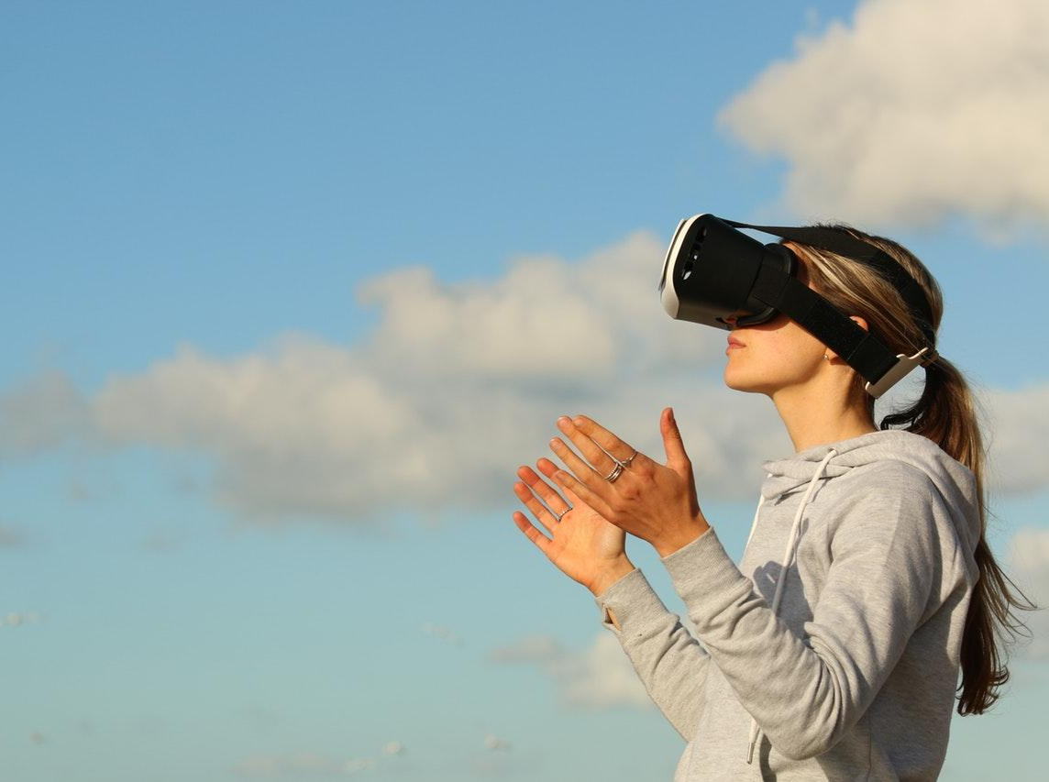
PRESENCE
Image credit: Image by Bradley Hook CC0

Slide 5
“Telepresence, often shortened to presence, is commonly referred to as a sense of ‘being there’ in a virtual environment and more broadly defined as an illusion of nonmediation in which users of any technology overlook or misconstrue the technology’s role in their experience.”
DEFINITION: PRESENCE
Definition from the International Society for Presence Research, https://ispr.info/

Slide 6
A psychological state or subjective perception in which even though part or all of an individual's current experience is generated by and/or filtered through human-made technology, part or all of the individual's perception fails to accurately acknowledge the role of the technology in the experience. [ISPR 2000]
DEFINITION: PRESENCE
Definition from the International Society for Presence Research, https://ispr.info/

Slide 7
SPATIAL PRESENCE
SOCIAL PRESENCE TRANSPORTATION
ENGAGEMENT
SOCIAL REALISM
Personal presence
Real presence
Symbolic presence
Mere presence
Mediated presence
Cultural presence
Social presence
Witness presence
Augmented presence
Immersive multimodal interactive presence
Copresence
Machine presence
Cognitive presence
Behavioral presence
Subjective personal presence
Environmental presence
Temporal presence
Physical presence
Self presence
Emotional presence
Remote presence
…
PERCEPTUAL REALISM
MEDIUM AS SOCIAL ACTOR
ACTOR WITHIN MEDIUM
SELF-PRESENCE
INVERSE PRESENCE
(TOO) MANY TYPES OF PRESENCE
Lombard and Sun, 2017

Slide 8
SPATIAL - I felt like I was in the SPACE OR ENVIRONMENT created by the technology
TRANSPORTATION - I felt like I WENT somewhere else, people or things CAME to me, or we went somewhere else TOGETHER
SOCIAL REALISM - The people, things and events I experienced through the technology COULD (or did) OCCUR in the real world
PERCEPTUAL REALISM - The people, things and events I experienced through the technology LOOKED, SOUNDED, and/or FELT as they would in the real world
ACTOR WITHIN MEDIUM - Even though I COULDN'T INTERACT with them, I FELT I WAS ACTUALLY WITH THE PEOPLE or characters who were available via the technology
PRESENCE + OUR ASSIGNMENTS

Slide 9
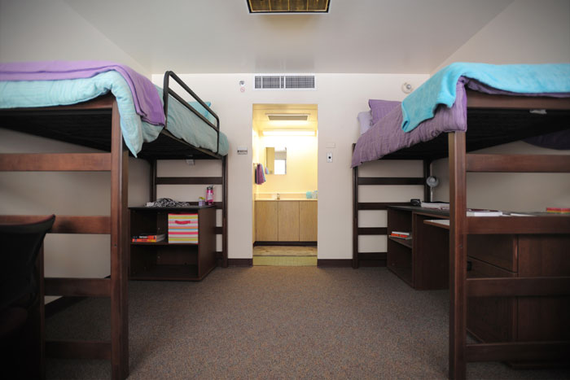
“I felt like I was in the SPACE OR ENVIRONMENT
created by the technology”
SPATIAL PRESENCE
Mexico State University - Dorms

Slide 10
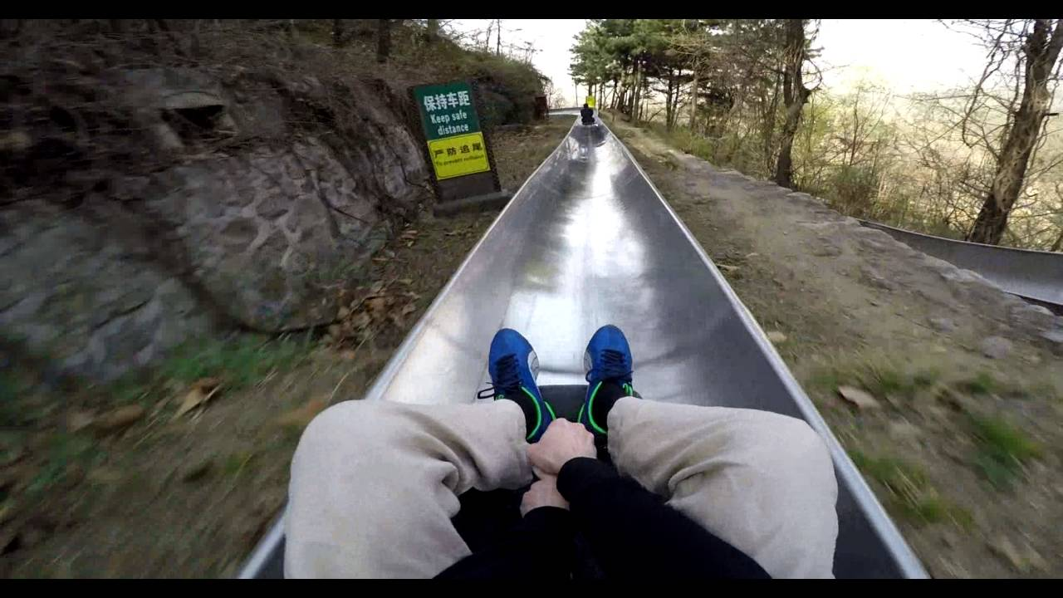
I felt like I WENT somewhere else, people or things CAME to me, or we went somewhere else TOGETHER
PRESENCE AS TRANSPORTATION

Slide 11
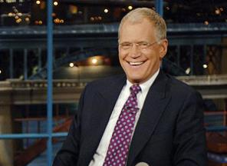
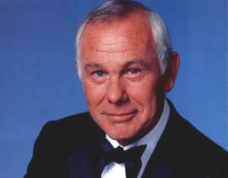
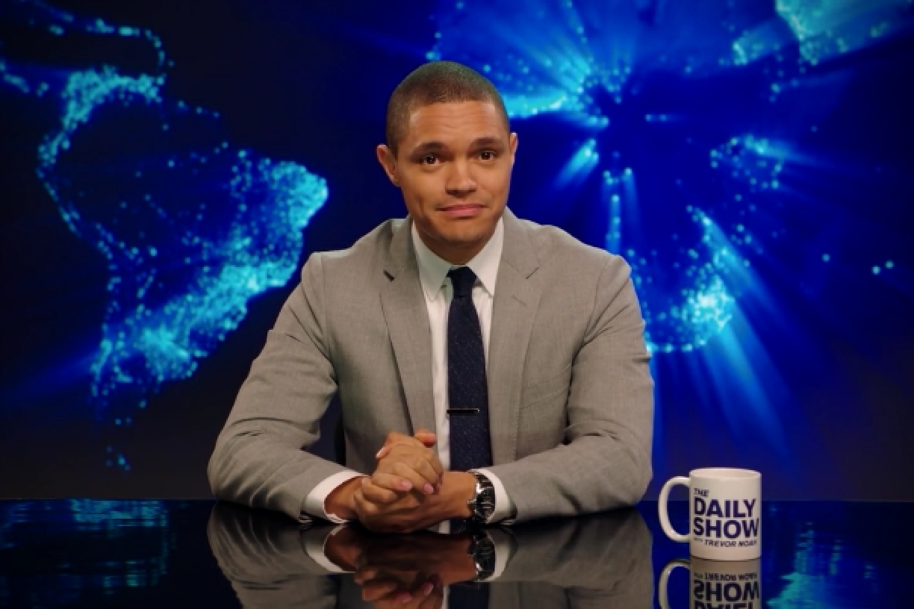

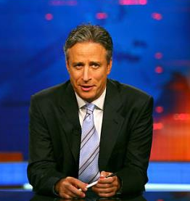

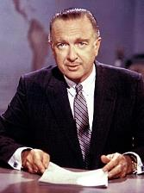
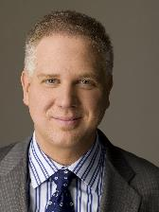

Even though I COULDN'T INTERACT with them, I FELT I WAS ACTUALLY WITH THE PEOPLE or characters who were available via the technology
SOCIAL PRESENCE (ACTOR WITHIN MEDIUM)

Slide 12
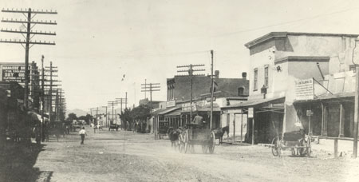
The people, things and events I experienced through the technology COULD (or did) OCCUR in the real world
PRESENCE AS SOCIAL REALISM
Historic image of downtown Las Cruces, NM – 1905 - http://www.las-cruces.org/code/history_exhibit/Images/Railroad/railroadMainStreet.html

Slide 13
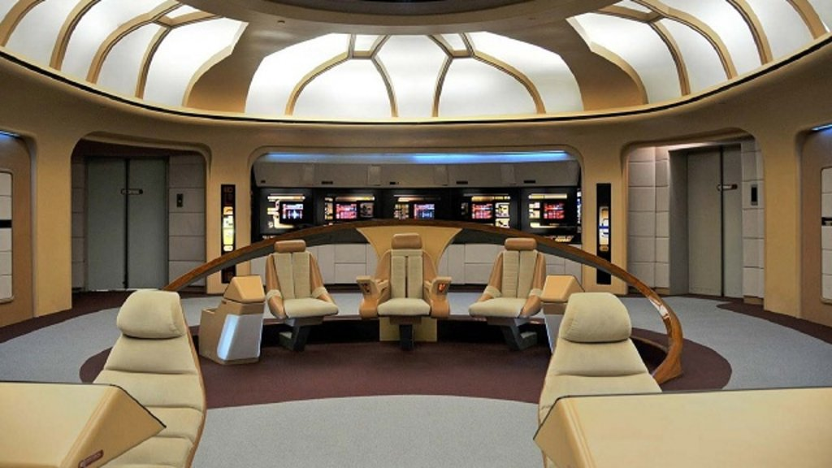
The people, things and events I experienced through the technology LOOKED, SOUNDED, and/or FELT as they would in the real world
PRESENCE AS PERCEPTUAL REALISM

Slide 14
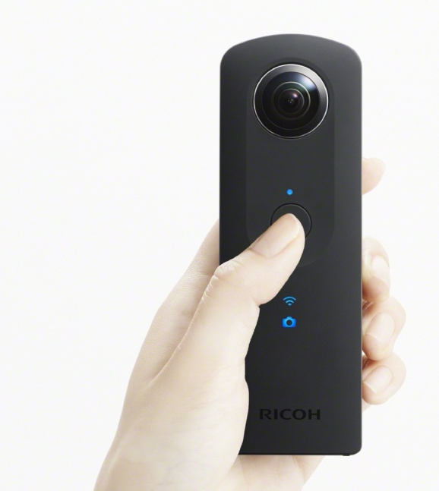
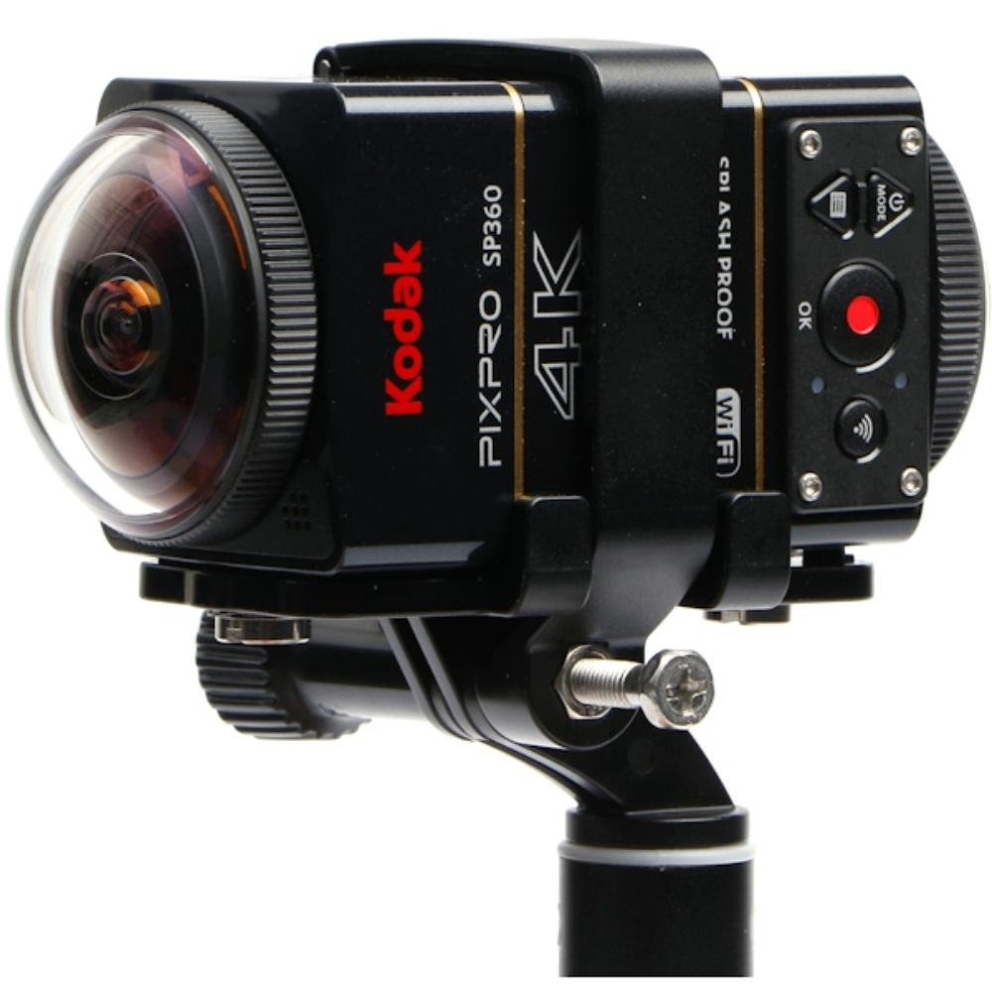
First, we filmed with the Ricoh Theta S HD resolution. No stitching required. Upload direct to YouTube.
Next, we filmed with the Kodak Pix Pro Dual Action Camera 4K resolution. Stitching required (two cameras). Adobe Premiere.
ABOUT OUR CAMERAS
Left image: The Ricoh Theta S. Right image: The Kodak Pix Pro Dual Action camera pack

Slide 15
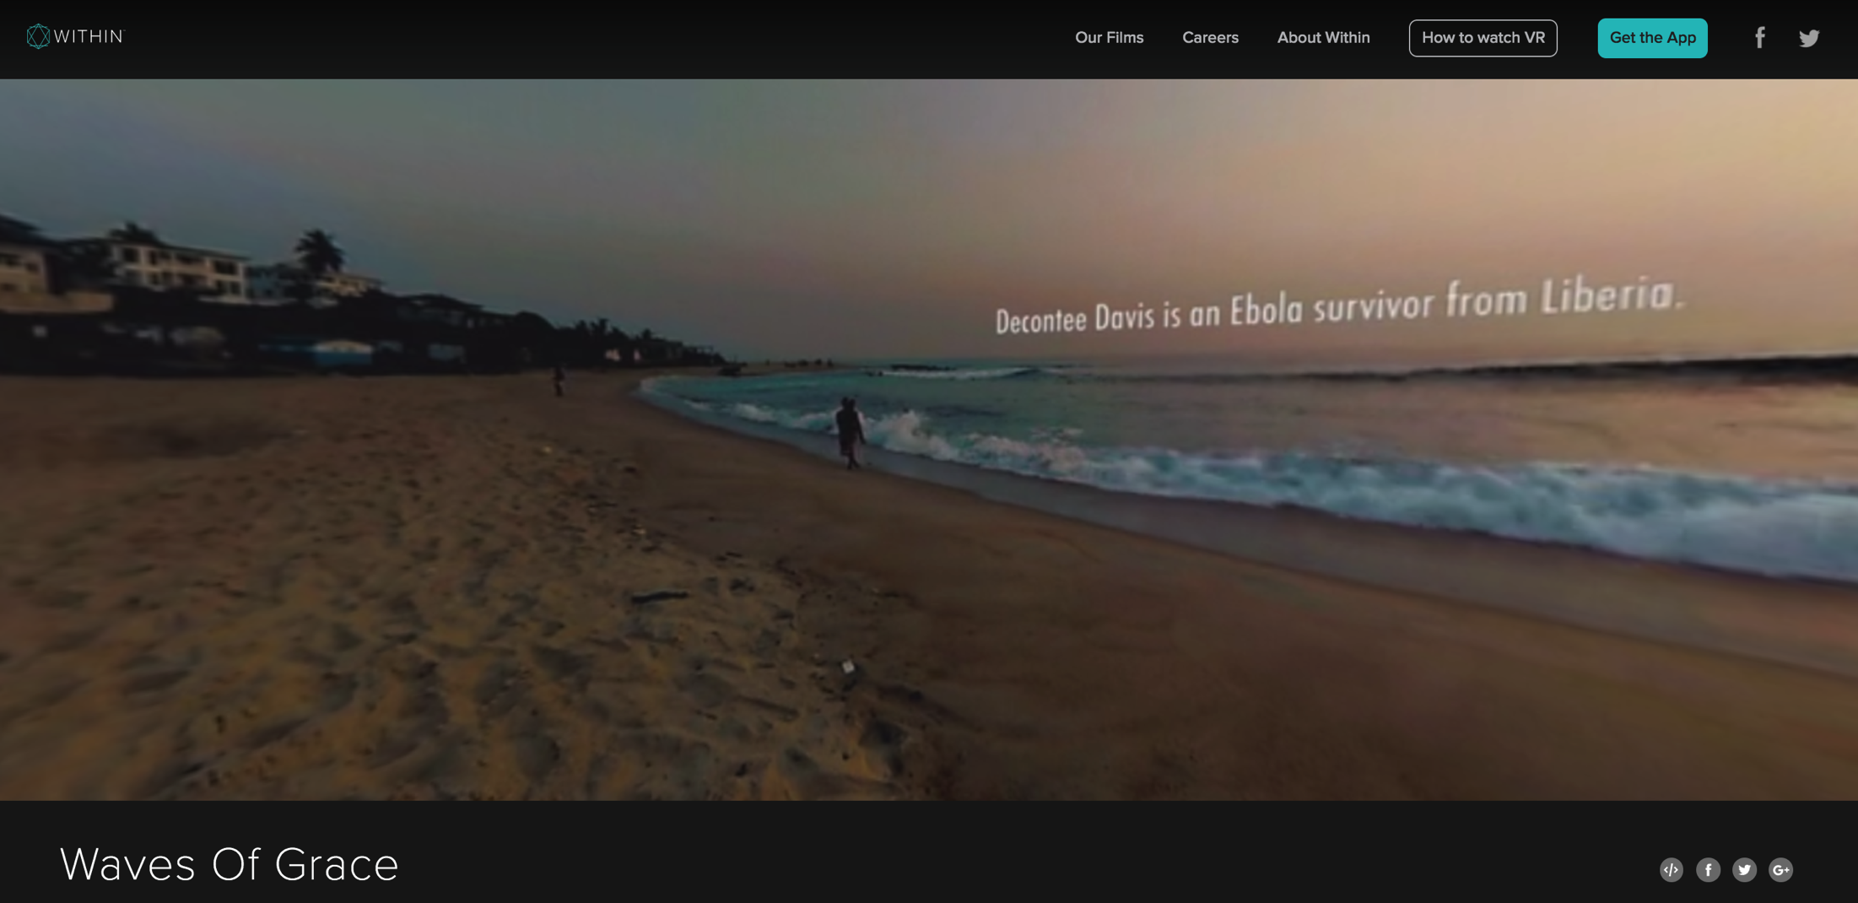
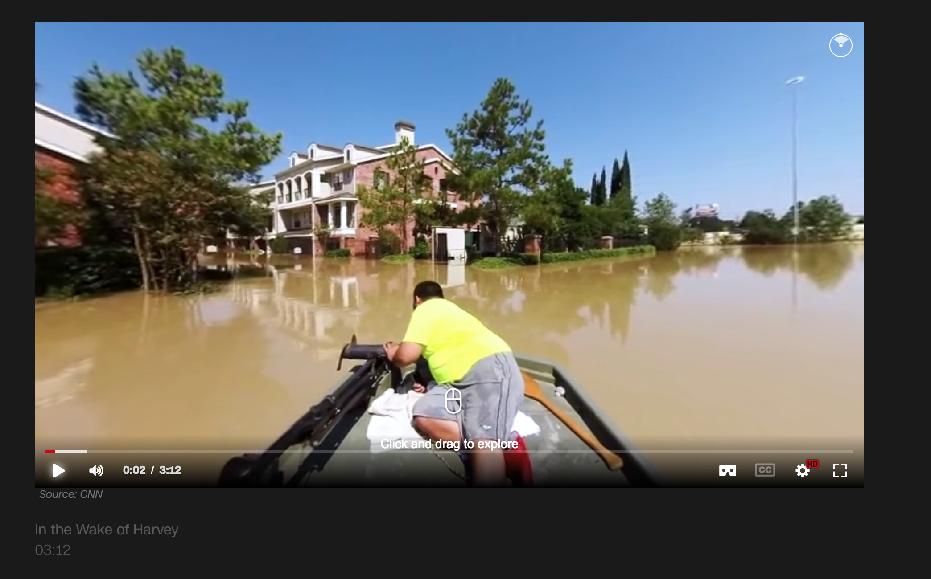
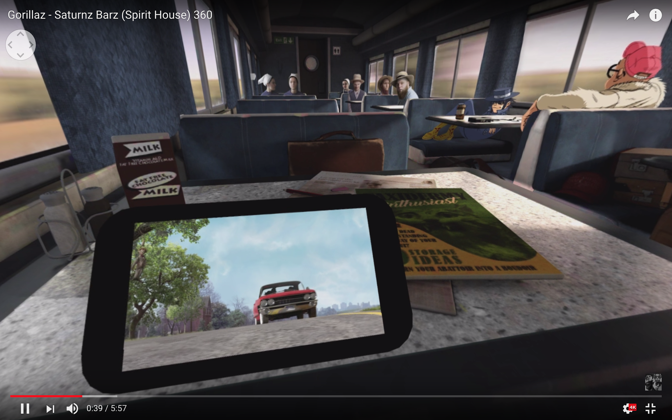
NEWS: In the Wake of Harvey CNN VR, footage of Hurricane Harvey
DOCUMENTARY: Waves of Grace With.in Media, ebola outbreak in Liberia
MUSIC VIDEO: Saturnz Barz (Spirit House) Gorillaz, a surreal animated music video
HORROR: Lock Your Doors YouTube, narrative, creative use of space
STUDENT WORK: Driving video “created by students like you”
REFERENCES / INSPIRATION

Slide 16
Text in VR? http://with.in/watch/waves-of-grace/

Slide 17
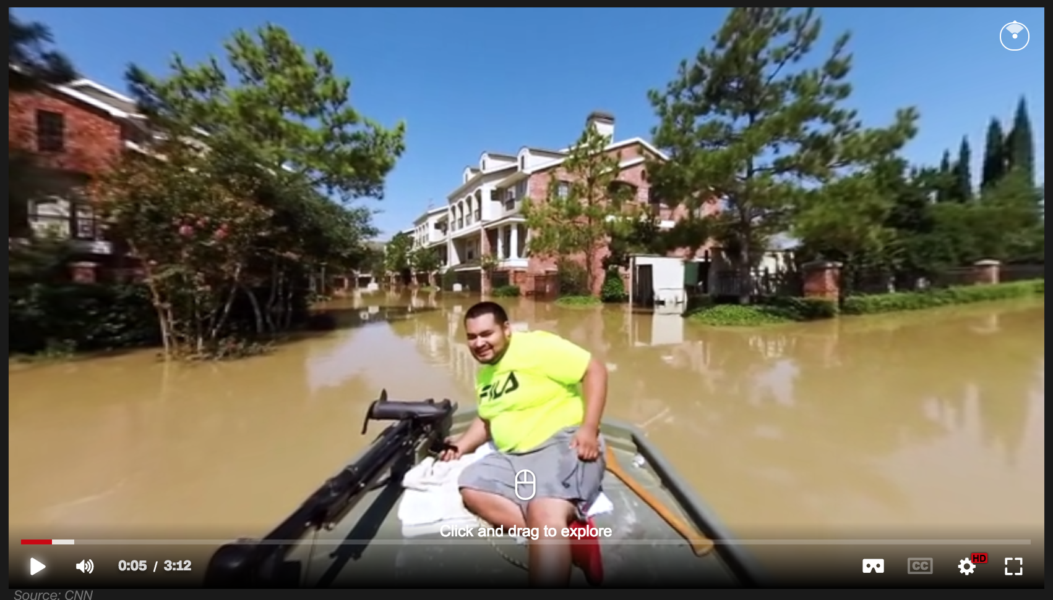
CNN VR: In the Wake of Harvey https://www.cnn.com/2017/09/09/vr/harvey-aftermath-vr-360/index.html

Slide 18
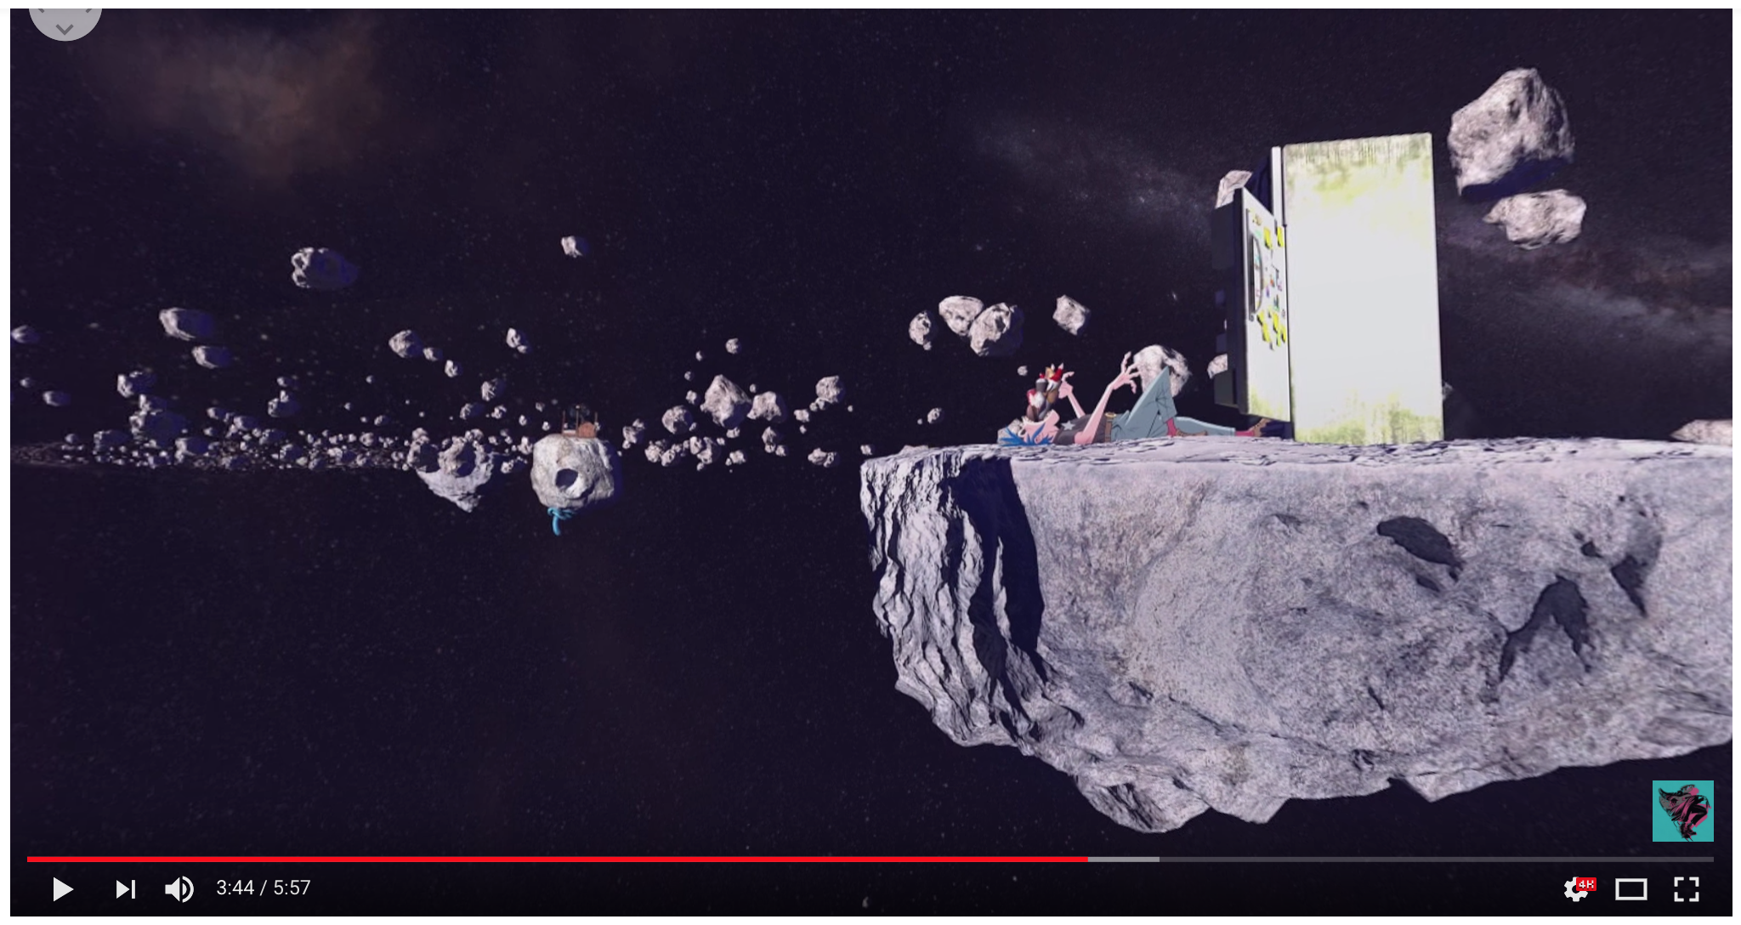
The Gorillaz: Saturnz Barz (Spirit House) 360 https://www.youtube.com/watch?reload=9&v=lVaBvyzuypw

Slide 19
LET’S FORM GROUPS!
PROJECT: FILM SEVERAL SHORT VIDEOS IN THE SAME PLACE. WHICH EVOKES THE STRONGEST EXPERIENCE OF PRESENCE?
FILM: TUESDAY, 9/11
DUE: By noon on THURSDAY, 9/13

