Slide 1
Telepresence in
Comic Art & Films
A report by Yichen Yang

Slide 2
Types of comic-to-film adaptations
Structural adaptation
Thematic adaptation
It features an almost precise correspondence of narrative events between comic source and film adaptation.
It has no relationship of narrative structure to the comic source, but retains thematic elements in the form of key conflicts and characters.

Slide 3
Telepresence in comics
Comics functions like a code.
reality approximation
“the interaction between the larger signs of the frame, the page, and the entire work within the context of “social reality” (Magnussen, 2000, p. 195)

Slide 4
“Illusion of nonmediation”
"comics are a representational art form devoted to the emulation of real experience" (Eisner, 1985, p. 91).
"The cartoon is the result of exaggeration and simplification" (Eisner, 1985, p. 151).

Slide 5
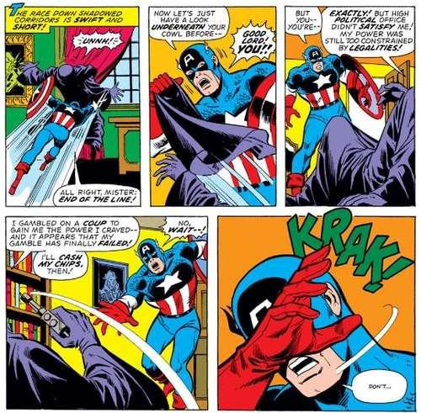
Disguising Conventions
"The panel acts as a sort of general indicator that time or space is being divided" (McCloud, 1993, p. 99).
Panels "establishes the position of the reader in relation to the scene and indicates the duration of the event" (Eisner, 1985, p. 28).
word balloons and panels
Notes:
the font + size of the word and the shape of the outline of the balloon = the emotion
panel -- contage

Slide 6
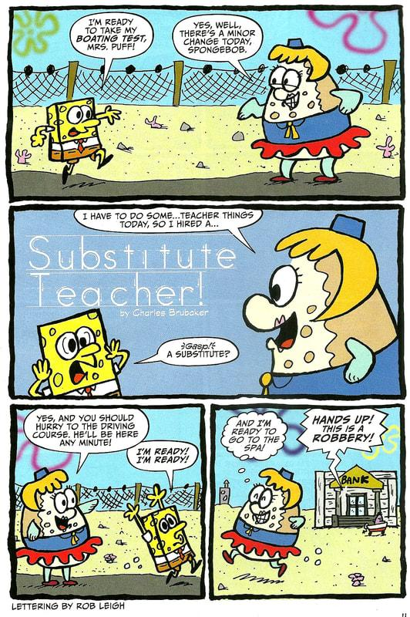
Four avenues
A. Boxed up and sequenced “time”
the continuum of the action = the passage of time
B. Outlines of the panel
the emotions = the graphic stylization of the panel outline
wavy panel borders: simulate the emotional experience of dreaming
fractured glass borders: to generate the emotion of anger

Slide 7
C. Border as a Structural element
The convention of the panel is naturalized to the point of invisibility.
D. “Undermined” panel
the panel "invites the reader into the action or allows the action to explode toward the reader" (Eisner, 1985, p.46)
giving the impression of access to the story on a deeper level (Ames, 1997)

Slide 8
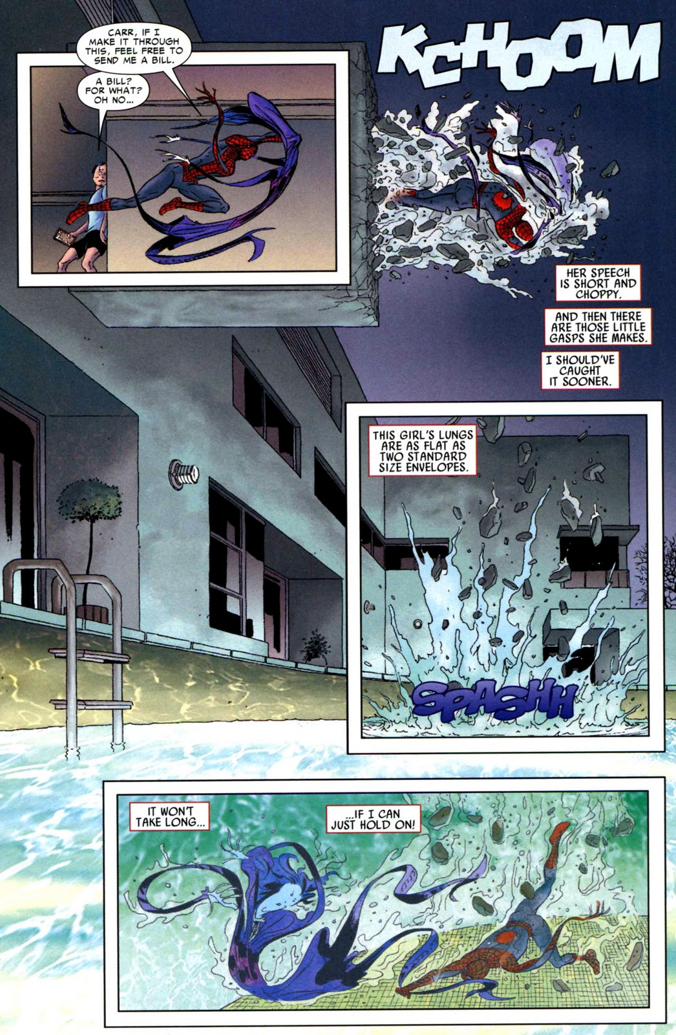
Closure
Definition
the phenomenon of observing the parts but perceiving the whole
How does reader relates separate frames to obtain a logical storyline?
Carrier (2000): "By forming some hypothesis about the previous or the next scene of the action" (p. 14).

Slide 9
Comics as an Immersive Experience
Slater (2003) - “Presence is a human reaction to immersion”
both a perceptual and psychological response (Lombard & Ditton, 1997).
Heeter (1992) deals with this concept in terms of the subjective experience of virtual worlds: "A sense of presence in a virtual world derives from feeling like you exist within but as a separate entity from a virtual world that also exists" (Heeter, 1992, p. 262).
Engagement
“Strip tease”
Page turning
1. gazing with intention
2. turning pages with intention
1. Narrative suspense
2. expectation driven by epistemophilia (the obsessive desire to know)
Turning pages is a evidence of the reader's power over and immersion within the narrative.

Slide 11
Three types of transportation
(Presence as Transportation)
“You are there”
“It is there”
“We are together”
Vital elements
(to obtain a sense of transported telepresence within the text)
The comic artist
The cartoon

Slide 12
Cartoon
Two kinds of experience
direct experience signifiers: next-door neighbors, coworkers and acquaintances…
Vergueiro (2001) observes the work of Carlos Zefiro in the following way: "Zefiro's protagonist was not a superman, nor a person with a particular advantage in terms of physical attributes; instead, he was a rather ordinary man experiencing extraordinary circumstances" (p. 74). Vergueiro follows up by suggesting that this "was the kind of situation any Zefiro reader could presumably find himself in" (p. 74).
the experience of other forms of media
Intertextuality can be used to provide a more complete conception of a character within the comic text and, especially, within a film adaptation of that text.

Slide 13
Telepresence in film
"The Concept of Presence"
(1) "invisible" editing, wherein discontinuities between shots are disguised through transitions which maintain the spatial and temporal consistency of the environment depicted on film,
(2) composition, lighting, and depth of field used to emphasize a three-dimensional appearance,
(3) the development of synchronization between dialog on the soundtrack and the lip movements of actors.

Slide 14
The feature film
“illusion”
The fictional world
"The awareness of the picture as a two-dimensional object, or even as an artifact, may recede to the background to a considerable degree, in favor of the illusion of looking into the virtual space" (Tan, 1996, p. 52)

Slide 15
"Veridical" perception of the natural environment
Our perception of mediated environments (such as those depicted on film) resembles reality only to the extent that the cues we have evolved to respond to in the natural environment are able to be reproduced. (Anderson, 1996)
"when the visual system, following its own internal instructions, arrives at a precept that is in error if compared to physical reality" (p.15)
As Anderson asserts, "The 'rule' of continuity of existence inherent in our visual system holds that objects that exist continue to exist until they are seen going out of existence" (p. 97).

Slide 17
Variable framing technologies
Indexing
our perspective moves forward through space, either as a result of the camera physically "trucking" forward or a zoom lens
Bracketing
particular objects are either included or excluded from the shot based on their salience to the action
Scaling
where particular aspects of the mise-en-scene are given prominence due to their dominant positioning within the shot

Slide 18
Embodiment in Narrative Media
The missing element in inherently narrative media (comics and film) as opposed to interactive media (videogames and virtual reality) is the physical body.
Transportation and perceptual immersion, two key components of the telepresence experience, presume the existence of a body to be transported and immersed.
Spatial Telepresence
Social Telepresence

Slide 19
Thank you!
Thoughts and comments?

