Slide 1
Measuring Telepresence
Stephen Ong and Eric Yang

Slide 2
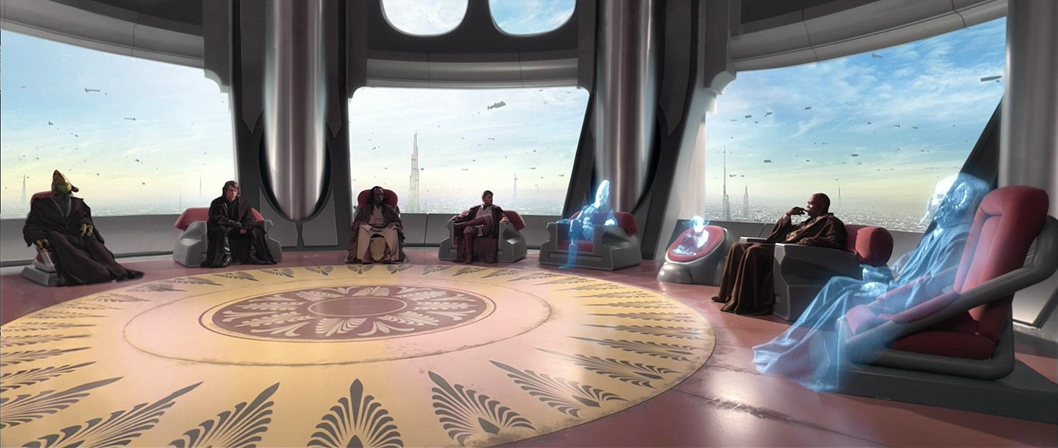

Slide 3
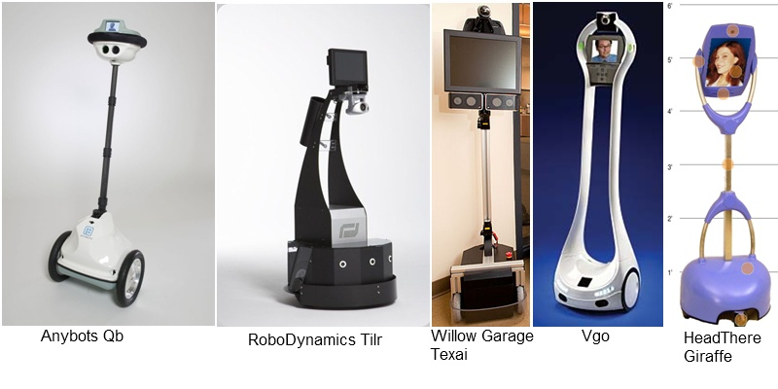

Slide 4
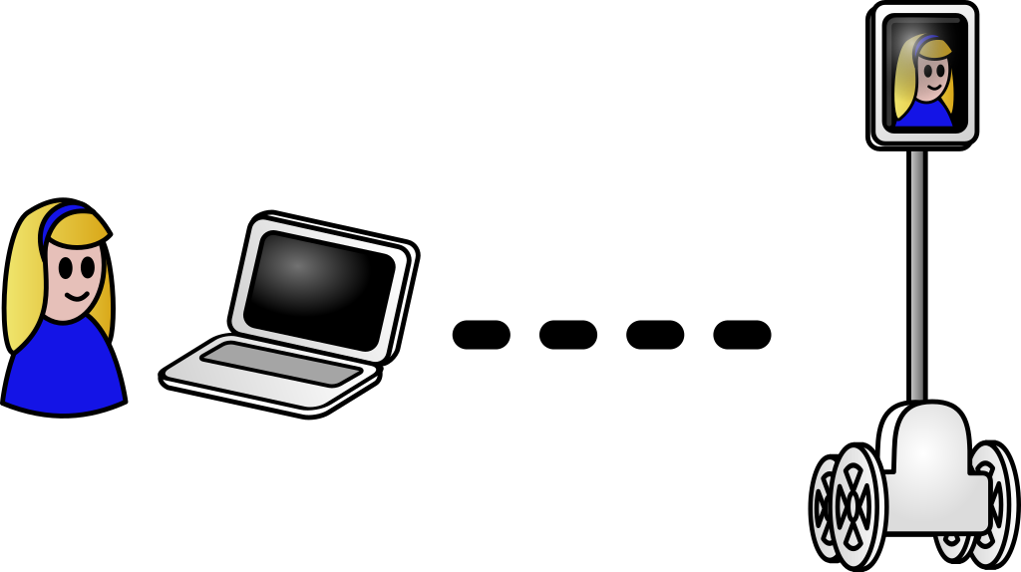

Slide 5
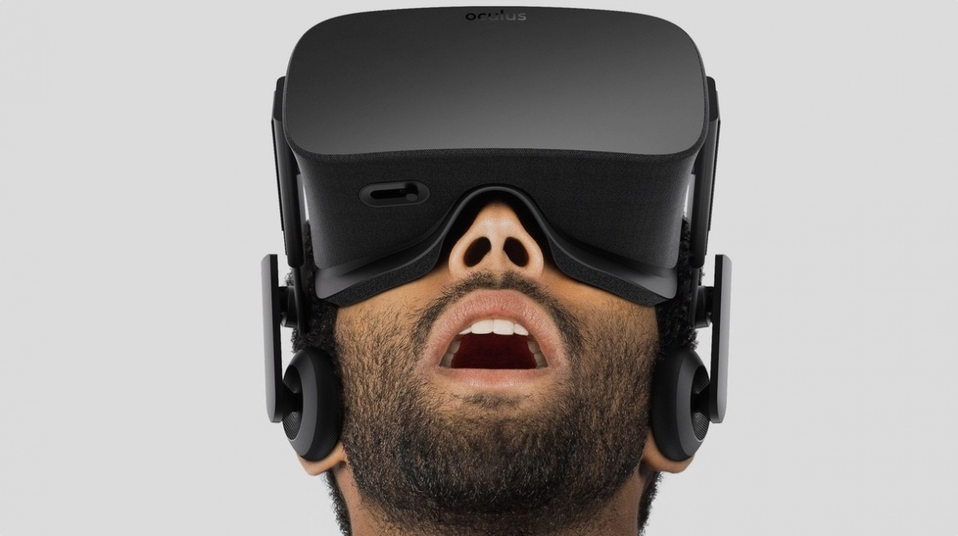

Slide 6
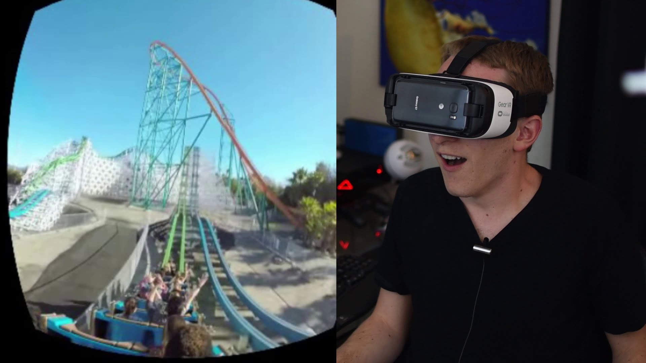

Slide 7
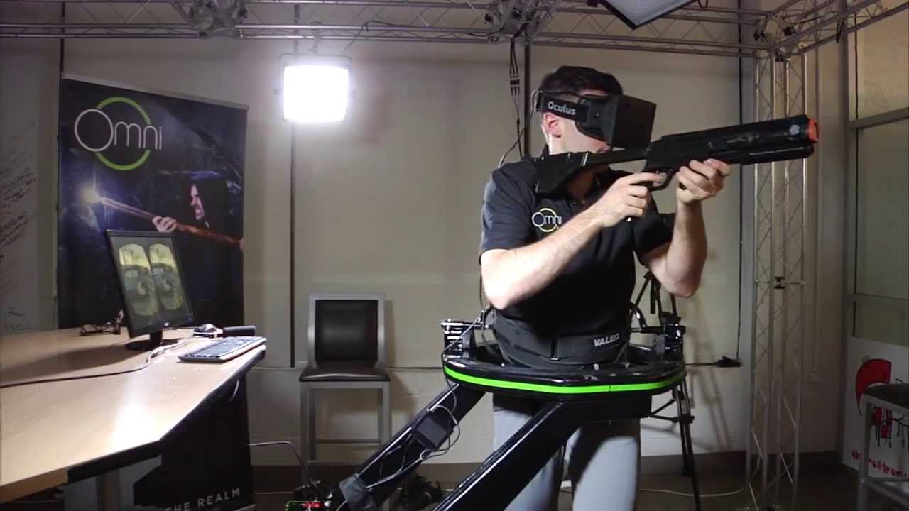

Slide 8
https://www.youtube.com/watch?v=fcLl-DZGLZ8

