Slide 1
CLCC & Presence Theory
Jessica Kelly and Valerie McIntyre

Slide 2
CLCC
CLCC is defined as the capacity-limited, cognitive constructionist model of virtual presence (Nunez pg. 106).
Social Presence is an example of CLCC
Example: Attending the Emergent Media Class Rough Cuts on Tuesday, October 11.

Slide 3
CLCC and Social Learning Theory Connection?
Social Learning Theory
Ecompasses memory, attention, and motivation
Media Effects
Albert Bandura
https://www.youtube.com/watch?v=hHHdovKHDNU (Bobo Doll Experiment)

Slide 4
Personal Conclusion on CLCC
CLCC
Ecompasses memory and behavior like Social Learning Theory, so there could be a connection between the two since they concentrate on Media Effects.
https://www.youtube.com/watch?v=fsEAqT9OC2s
(Tech Insider: Kids Try VR For the First Time)

Slide 5
Spatial Presence
Spatial Presence occurs when a mediated environment is perceived as non-mediated
This is not limited to technology!

Slide 6
Two- Pole/ Three- Pole Model
Two Pole- Users are present in actual and virtual space
Three Pole- Includes mental imagery space

Slide 7
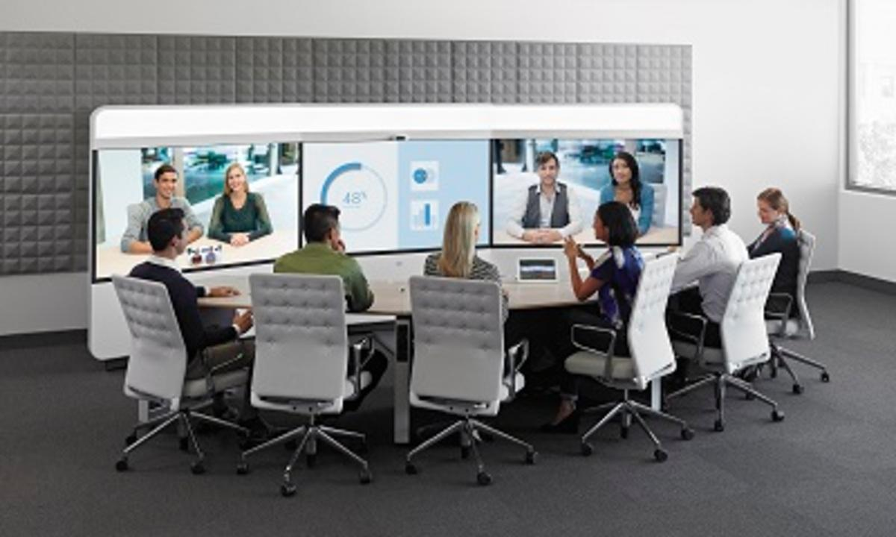
Focus, Locus, Sensus
The more someone focuses on external environment, presence will rise
Locus- Real world vs. Virtual world
Sensus- Conscious vs. unconscious

Slide 8
Social Presence
https://www.youtube.com/watch?v=WzV6mXIOVl4
Parasocial Interaction, self-presence in novel bodies, media equation

