Slide 1
Telepresence and Art; comics, graphic novels and adaptations to film
The collaborative subject: Telerobotic performance and identity by D.Z. Saltz
Presented by Amriana Dean

Slide 2
Introduction
Digital Technology is augmenting our notions of the self
We can control avatars in virtual environments
We can become cyborgs through tech enhancements
Digital Technology is augmenting our notions of space
Virtual reality systems - immerse a subject in a computer simulated environment (purely virtual -no real world coordinates)
Telepresence - conjoins two or more real world locations using computers, telecommunications and robotics
VR is simulacral (an imitation) while telerobotics is distal (extends the bodies capabilities)

Slide 3
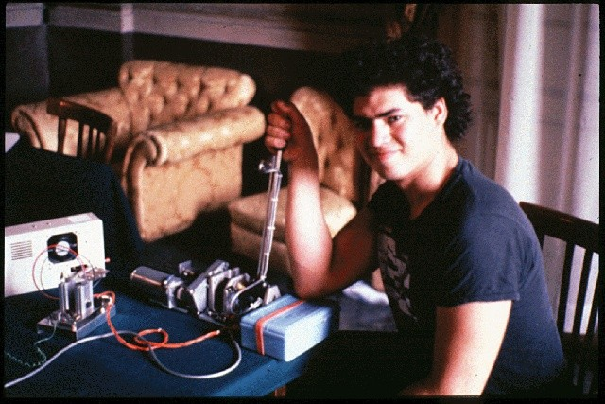
Telepresence and Telerobotics: Where am I?
Dennet’s critique of Cartisean theater
“The notion that the subject exists as a point of consciousness in the brain, gazing through the eyes out into the world”
Ultimately, we should rethink our notion of space in terms of limiting our existence to a singular geographic location.
Telerobotics and telepresence have made this separation of mind and body possible
Technology can achieve what our bodies restrict
E.g. sea and space rovers
http://v2.nl/archive/works/telephonic-arm-wrestling

Slide 4
Telepresence and The Subject
Contemporary Telerobotics Artists
use technology to expand the capabilities of the subject
provide a sensation of an unmediated experience , interface acts as a window
Tillie, the Telerobotic Doll http://www.lynnhershman.com/tillie/
Types of Technology and Human relationships
Embodiment - tech serves as an extensions of the person’s senses or limbs
Hermeneutic- technology must be focused on an interepreted to gain knowledge about the world e.g. thermometer
Alterity -positions the technology as the object of interest, focus of investigation
Digital tech transforms human subjectivity : oral to written to virtual OR human to posthuman

Slide 5
Telepresence and Community
Technology also has the ability to transform social interactions
Telematics
allows for multiple subjects by promoting collaboration between artists in separate geographic locations
Satellite Arts Project, 1977 http://www.ecafe.com/getty/SA/
How much differences does the use of telematics make?
concerns about authenticity
“Telematics acquires its greatest impact when the spectators are given the ability to interact directly with people at the remote site, and thereby can experience the uncanny collapse of space first-hand”
Hole in Space, 1980 http://www.ecafe.com/getty/HIS/

Slide 6
The Collaborative Subject
A single subject that is reliant upon the contributions of multiples subjects
Collaborative subjectivity emphasizes group action in pursuing a common goal
Project Paradise
Two rectangular booths and a cylindrical chamber
Cyborg adam and cyborg eve: naked except for metal braces
See inside chamber through cameras
Interact with them through telephones and buttons

Slide 7
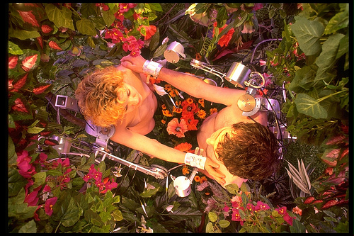
Theatrical Actors
The actors’ fictional actions are complicated by the physical intimacy.

Slide 8
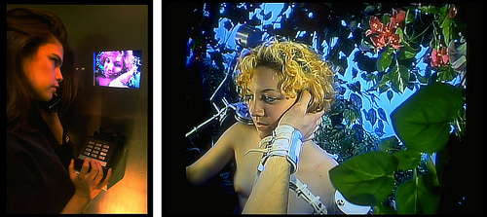
Collaborative Agency
“The telerobotic technology does not merely transform an individual human being, either the participant or actor, into a cyborg, it is conduit that links the participant’s subjectivity to the actor’s”
What is the participant’s role in relation to the actors?
author, director, puppeteer,
First person perspective created by the camera position implicates you as the subject of the character’s actions
Alterity relationship will become a hermeneutic relation and approach an embodiment relationship
Participant’s role as the author is also collaborative
dependant upon the choices of the artists and engineers
Telephone acts as a barrier

Slide 9
Subject Position
The two participants don’t know who they’ll play because the boths are assigned arbitrarily
Homophobic participants may take issue with being assigned the “wrong” subject position
Awareness that I am the object of the actor’s gaze
Other actor being guided a participant whose gender you don’t know
All these conflicts in regards to of identity go against what some would can an “ideology of compulsive heterosexuality” implied by the Adam and Eve characters

Slide 10
Identity in Question
Project paradise gives rise to virtual agents
They have no fixed real world identity
just like a virtual space has no fixed location in the real world
They perform actions that go beyond human intentionality
Result of collaboration

Slide 11
The Ubiquity of The Collaborative Subject
The collaborative subject can be seen in common phenomena
A TV hosts receiving instructions from a teleprompter
A movie actor’s voice being dubbed by another actor
In fact, all actors on screen are collaborative subjects
Live theatrical performance
Is some degree of collaborative subjectivity inherent to all types of performance?

