Slide 1


An Introduction to (Tele)Presence and its Roles and Impacts for Children
Matthew Lombard, PhD
Temple University
International Society for Presence Research

Slide 2
Overview
Defining (tele)presence
Creating presence
Why it matters
Presence and children

Slide 3
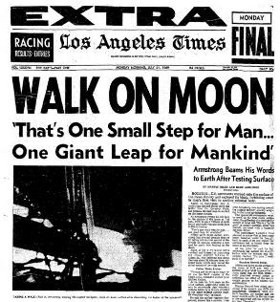
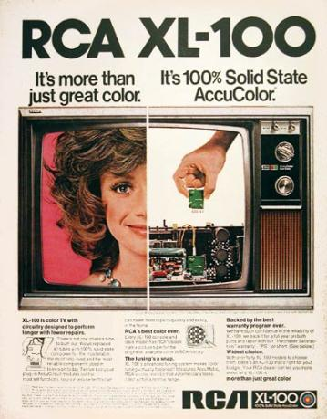
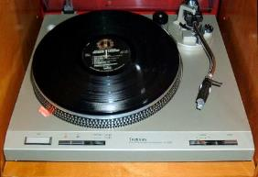
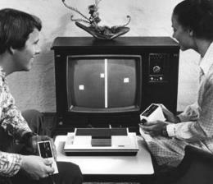
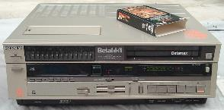
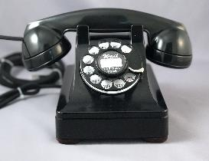
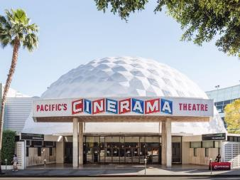

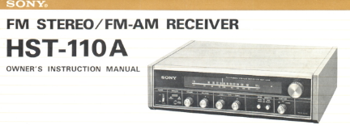
Media then (1970s)

Slide 4
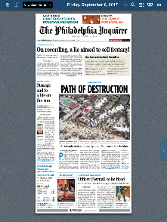
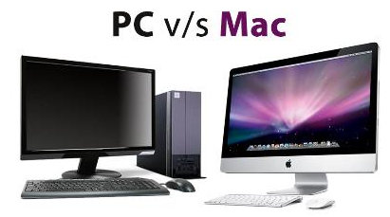
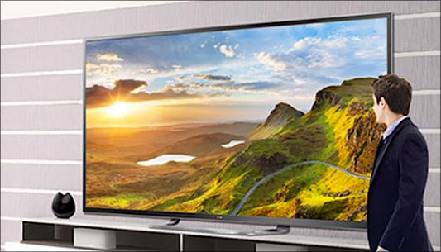



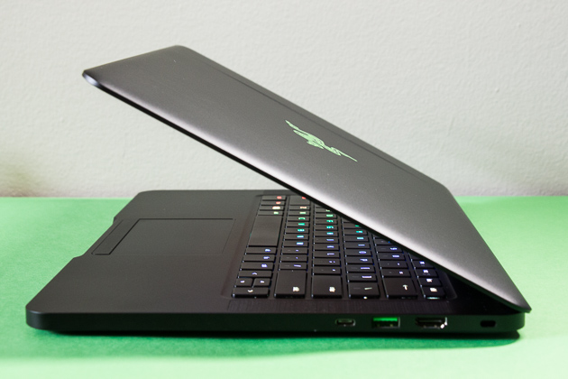
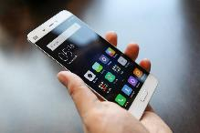
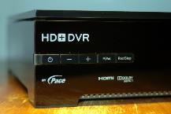

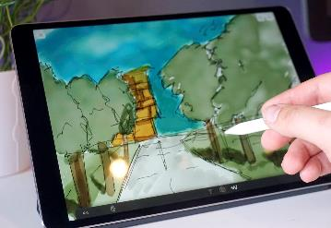

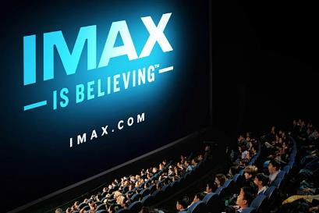
Media now (2010s)
v

Slide 5
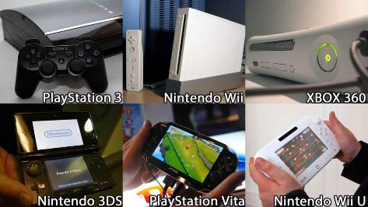
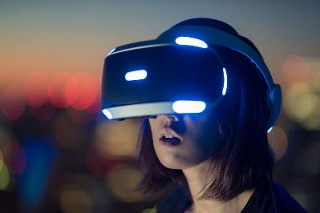
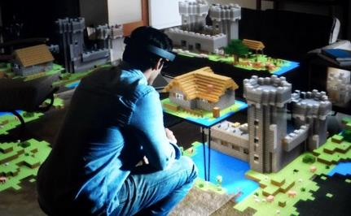
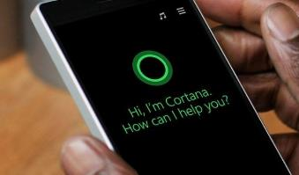

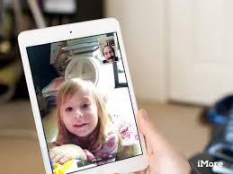

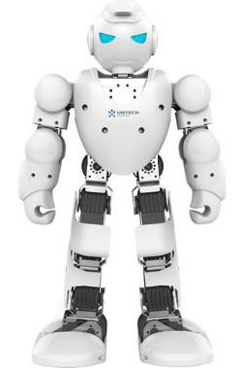
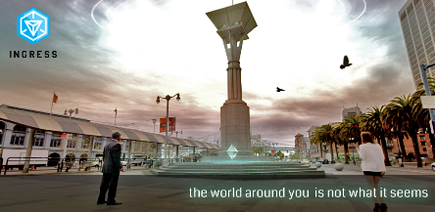

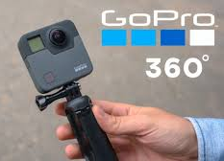
Media now (2010s)
v

Slide 6
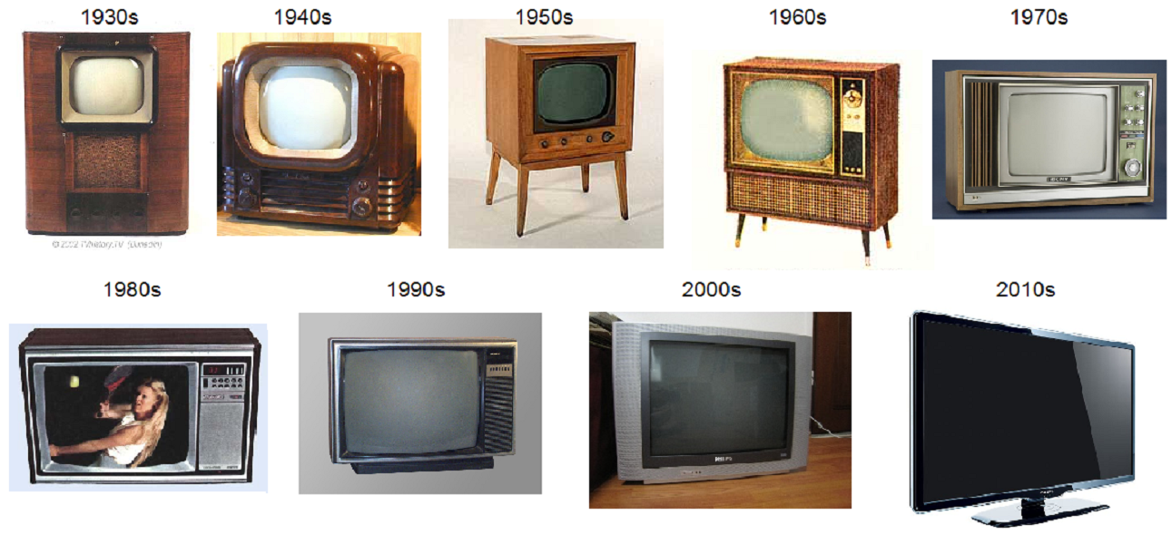
How media tech evolves

Slide 7
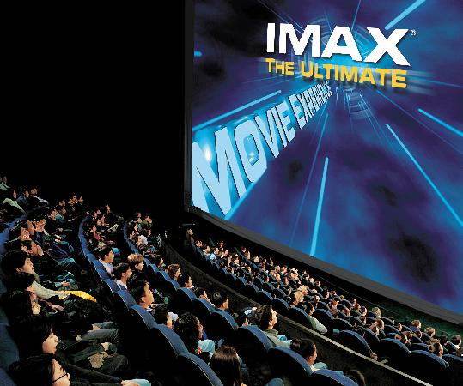
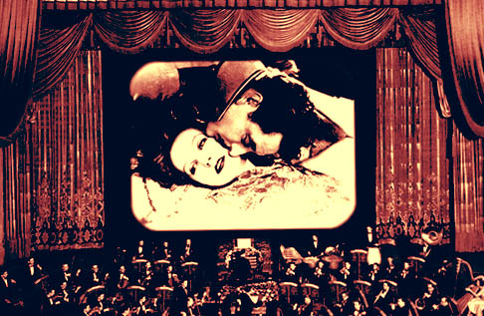
How media tech evolves

Slide 8
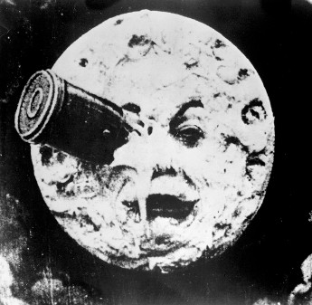
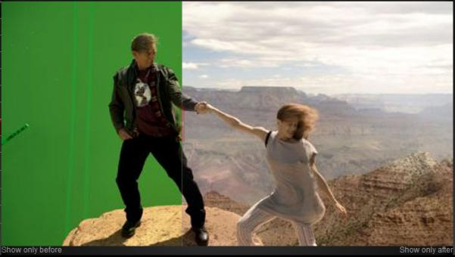
How media tech evolves

Slide 9
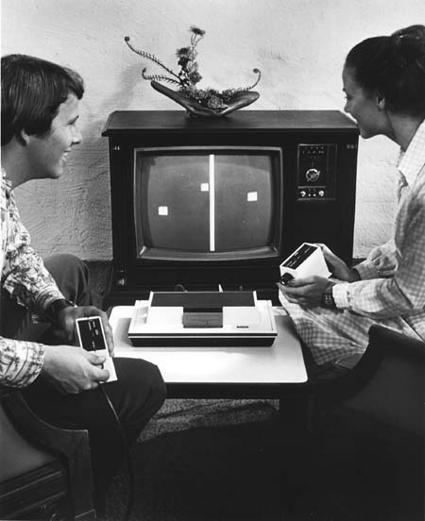
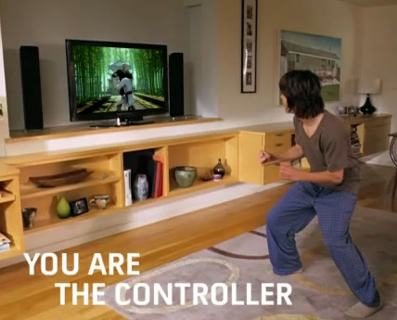
How media tech evolves

Slide 10
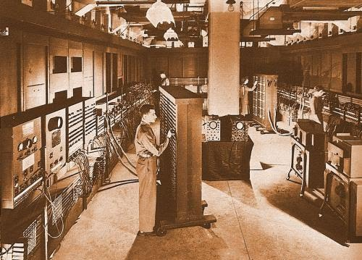
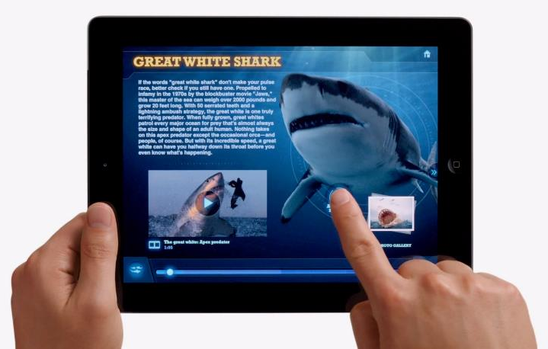
How media tech evolves

Slide 11
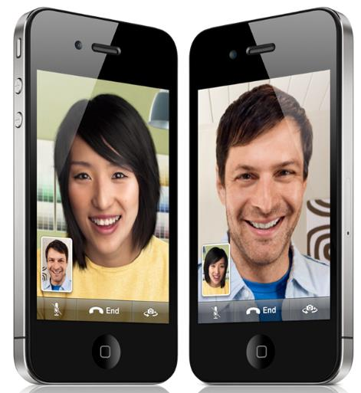
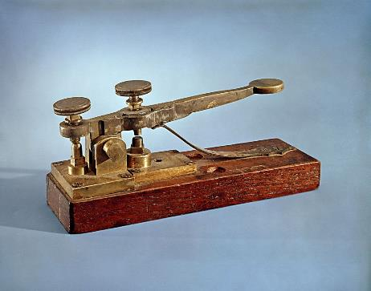
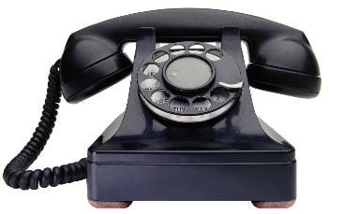
How media tech evolves

Slide 12
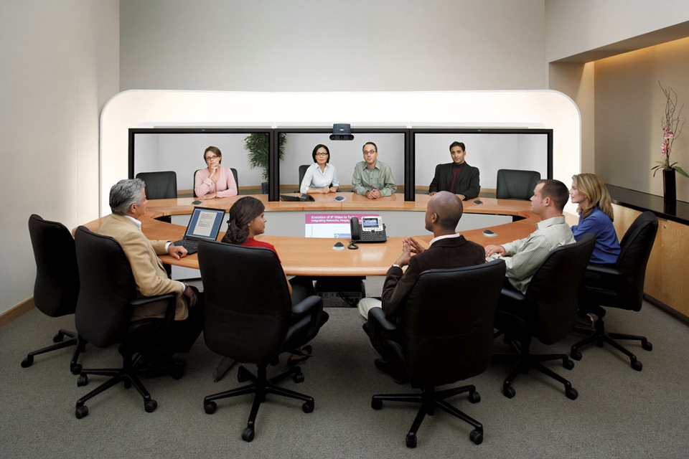
How media tech evolves

Slide 13
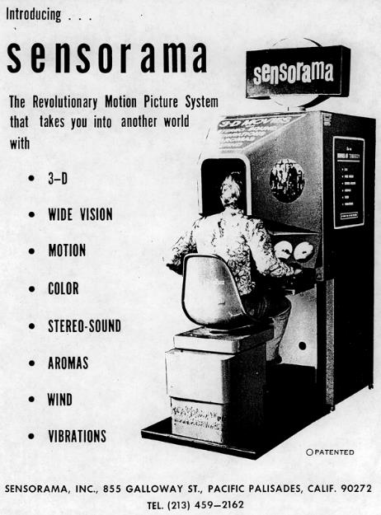
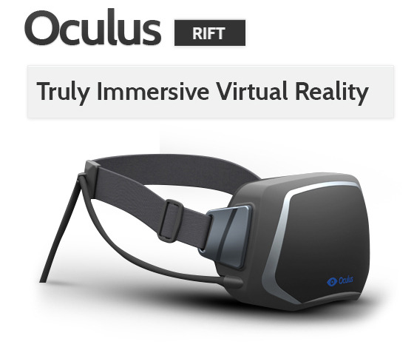
How media tech evolves

Slide 14
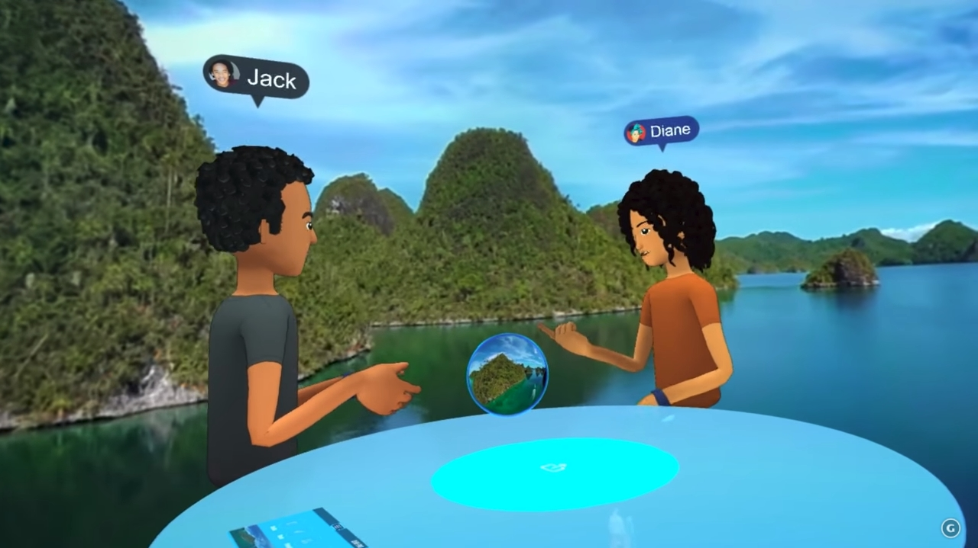
How media tech evolves
https://www.youtube.com/watch?v=PVf3m7e7OKU

Slide 15
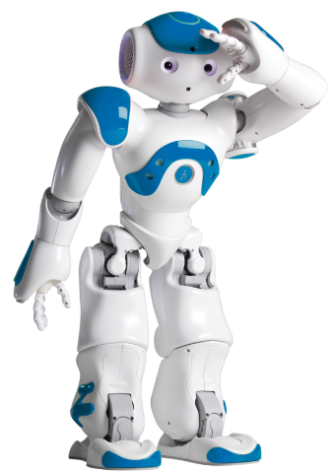
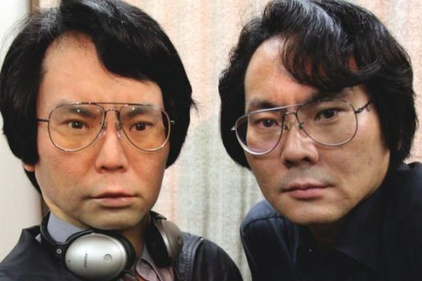
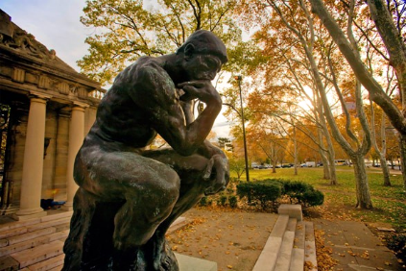
How media tech evolves

Slide 16
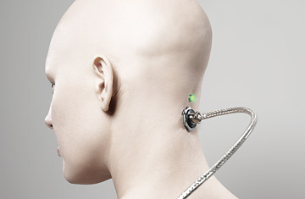
How media tech evolves

Slide 17
How media tech evolves
Using technology is becoming more
natural
intuitive
comfortable
easy
simple
automatic
‘real’
because it seems less like technology

Slide 18
Defining (tele)presence
A psychological state or subjective perception in which even though part or all of an individual's current experience is generated by and/or filtered through human-made technology, part or all of the individual's perception fails to accurately acknowledge the role of the technology in the experience.
[ISPR 2000]

Slide 19
Defining (tele)presence
“... When telepresence happens, the user feels present in or connected to the people or things in the media experience. We still know we're using a technology, but at some level we ignore the technology and just perceive the people, things and events of the experience. For example, we get ‘lost’ in the world of a novel, TV show, movie, videogame or theme park ride; we're convinced by the realism of paintings or graphic designs; we treat our cars, computers or other machines as if they have personalities of their own, and we feel like we're ‘with’ a person we talk to on the phone or in a videoconference. These are just a few examples; telepresence can happen with many other media too. ...”

Slide 20
Defining (tele)presence
A “perceptual illusion of nonmediation”
Real-time during media use
Not a disorder or abnormal
Property of media user
Result of media form and content,
media user characteristics and
media context/environment
A fragile ‘spell’ easily broken

Slide 21
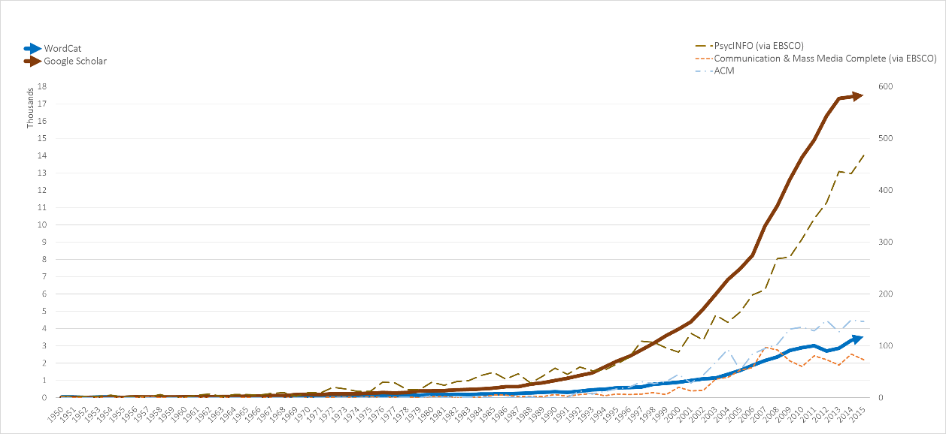
Presence research and theory
1990
2000
2010

Slide 22
Presence research and theory
An interdisciplinary area
Communication
Psychology
Computer Science
Philosophy
Medicine
Business
Education
Art
many others…

Slide 23
Spatial presence
“I felt like I was in the SPACE OR ENVIRONMENT created by the technology”

Slide 24
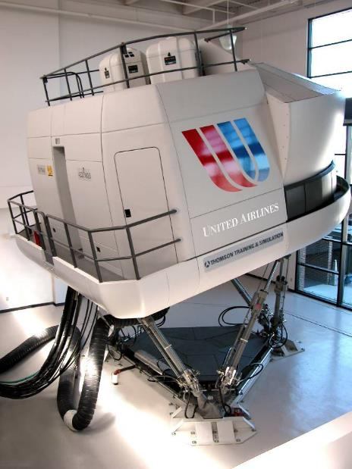
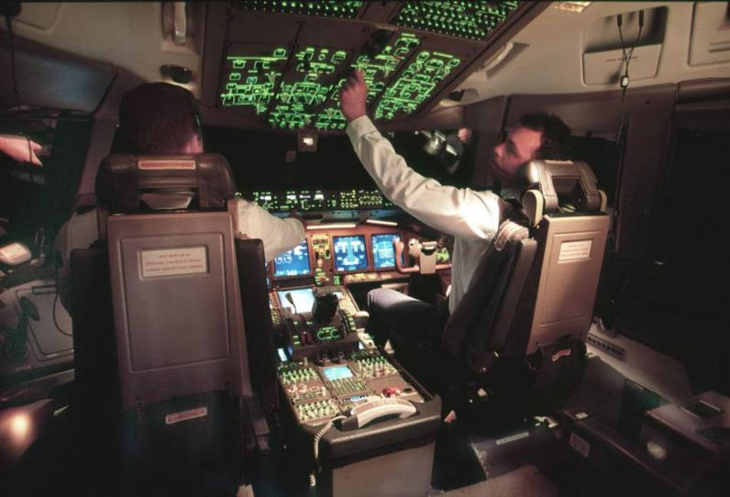

Slide 25
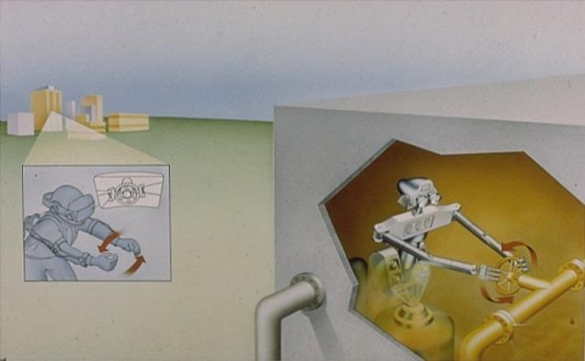
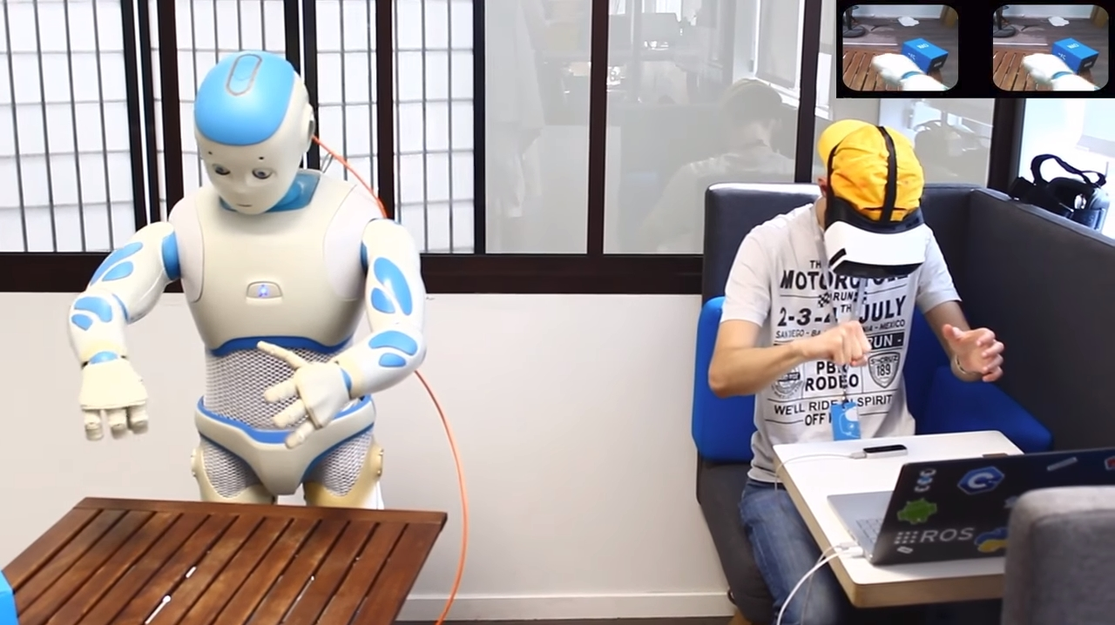
https://www.youtube.com/watch?v=CxmvPB3by1w

Slide 26



Slide 27
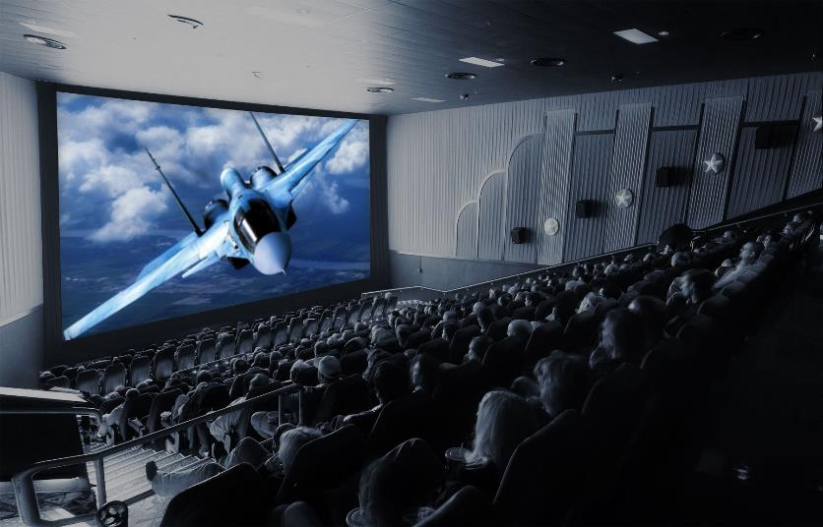


Slide 28

https://www.youtube.com/watch?v=ZJJU72CZiF8

Slide 29


Slide 30

https://www.youtube.com/watch?v=hRmkkrafboo

Slide 31



Slide 32



Slide 33


Slide 34

https://www.youtube.com/watch?v=WSRcDrCse7c

Slide 35



Slide 36


Advertising

Slide 37

https://www.youtube.com/watch?v=z7VYVjR_nwE
https://www.youtube.com/watch?v=4Ibe17-JMCU

Slide 38


Slide 39
Social presence – 1 way
(actor within medium)
“Even though I COULDN'T INTERACT with them, I FELT I WAS ACTUALLY WITH THE PEOPLE or characters who were available via the technology”

Slide 40




Slide 41












Slide 42


Slide 43

http://maartenbaas.com/real-time/schiphol-clock/

Slide 44
Social presence - 2 way
“I felt I was actually with the PEOPLE who were available via technology”

Slide 45


Slide 46



Slide 47


Slide 48


Virtual testimony

Slide 49


Slide 50


Slide 51



Slide 52




Slide 53




Slide 54

https://www.youtube.com/watch?v=Zmqva2rkVXA
https://www.youtube.com/watch?v=7ZFRC1ab-uk

Slide 55
Social presence - 2 way
“I felt I was actually with the PEOPLE who were available via technology”
with artificial actor

Slide 56


Customer service

Slide 57




Slide 58
Medium as social actor (MASA) presence
“The technology itself SEEMED TO HAVE A PERSONALITY (including computers, phones, robots, mannequins, etc.)”

Slide 59




Slide 60







Slide 61



Slide 62



Slide 63

https://www.youtube.com/watch?v=cV_D2hC50Kk
https://www.youtube.com/watch?v=W0_DPi0PmF0

Slide 64
Multiple kinds of presence!

Slide 65



Slide 66
Overview
Defining (tele)presence
Creating presence
Why it matters
Presence and children

Slide 67
Creating presence
Research, theory and experience suggest steps to increase presence via FORM:
Make images (and field-of-view) big
Increase image and sound resolution/quality
Use subjective camera shots
Comfortable to high volume
Add stimulation of more senses (e.g., touch, smell)

Slide 68
Creating presence
Research, theory and experience suggest steps to increase presence via FORM:
Make experience interactive with natural interface, accurate tracking
Reduce lags
Make it seem live vs. recorded, constructed
Hide technology, remove glitches
Use gradual transitions pre/post experience

Slide 69
Creating presence
Research, theory and experience suggest steps to increase presence via CONTENT:
Make it plausible (socially realistic)
Make it personally relevant
Avoid media conventions (formula plot/dialogue, 555-, etc.)
Make task or activity moderately challenging

Slide 70
Creating presence
Research, theory and experience suggest steps to increase presence via CONTEXT:
Create/encourage relaxed and comfortable physical and social settings

Slide 71
Overview
Defining (tele)presence
Creating presence
Why it matters
Presence and children

Slide 72
Why presence matters
Common – increasingly as media tech evolves
Central – applications across nearly all fields and endeavors, especially communication
$$ – basis for diverse large, profitable markets
Effects – on individuals, couples, families, organizations, societies, nations
Ethics – raises big issues and challenges
Cool – just really interesting (!)

Slide 73


Why presence matters
http://bgr.com/2017/12/30/meet-the-ai-startup-that-wants-to-make-a-digital-copy-of-every-person-in-the-world/

Slide 74


Why presence matters
A

Slide 75

Our presence projects
Presence and music (2006), with Jack Klotz
Presence and sexuality (2013), with Matthew Jones
Presence and death (2008), with Melissa Selverian
Presence and philosophy (2011), with Matthew Jones and Joan Jasak

Slide 76
Our presence
projects
Presence in popular culture (ongoing), with many people

Slide 77
Overview
Defining (tele)presence
Creating presence
Why it matters
Presence and children

Slide 78
Presence and children
Logically children should be more susceptible to presence illusions
How do/should they learn to perceive and use illusions?
What are the effects of children experiencing presence?

Slide 79
Presence and children
TYPES OF REALITY DISTINCTIONS [Source: Berry & Anderson: ch. 3]
nonmediated vs. mediated (presence as ‘illusion of nonmediation’)
actual vs. not actual (it’s happening/has happened, as in news, vs. it’s fiction/fantasy, as in entertainment; a sub-distinction: if it’s actual, is it live or recorded?)
plausible vs. implausible (even if it's not actual, could it happen? Is it ‘socially realistic’ and/or ‘perceptually realistic’?)

Slide 80
Presence and children
WHEN DO CHILREN UNDERSTAND THESE DISTINCTIONS? (1 of 2)
[Source: Flavell et al.; Lombard & Ditton, 1997]
Step 1 (0-3): TV objects are perceived as physically present objects that can be acted on; "there are people in the box."
Step 2 (3-?): TV objects are perceived as having a different status so that they can't be acted on, but what they are is unknown.
In these steps, children may ask someone to turn on the TV and regardless of the program, the child will want to see their favorite character.

Slide 81
Presence and children
WHEN DO CHILREN UNDERSTAND THESE DISTINCTIONS? (2 of 2)
[Source: Flavell et al.; Lombard & Ditton, 1997]
Step 3: TV objects are understood to exist somewhere else, with the images only representing the objects, but the child thinks the images and sounds perfectly represent the referents themselves (i.e., everything is actual); "what's an actor?" is still a valid question in this step.
Step 4: Not every object and event on TV is believable/plausible (i.e. what Berry authors call social realism). These perceptions depend on experience, not just cognitive development.

Slide 82


Slide 83



Slide 84
Presence and children
http://www.nickjr.com/blues-clues/

Slide 85

Presence and children
https://www.youtube.com/watch?v=FE2I6G2_ogk

Slide 86


Presence and children

Slide 87

Presence and children
https://learningenglish.voanews.com/a/robot-goes-to-school/3830253.html

Slide 88


Presence and children
http://wowwee.com/
https://www.youtube.com/watch?v=fSByydx1JdU

Slide 89

More information
Matthew Lombard
http://matthewlombard.com
lombard@temple.edu
International Society for Presence Research (ISPR)
http://ispr.info

Slide 90
Discussion questions
What kinds of presence have you experienced? What were the details of a memorable presence experience you’ve had?
What characteristics of media experiences do you think help us understand the reality distinctions above (mediated-nonmediated, actual-not actual, live-recorded, plausible-implausible)?
Do you remember learning how to make the reality distinctions and/or have you noticed children learning them?
How do you think the evolution of media technologies over the next few decades will affect our, and children’s, ability to make the reality distinctions?

